Slide 1
PMC-592 HMI's Front Panel Operation
September 29, 2016

Slide 2
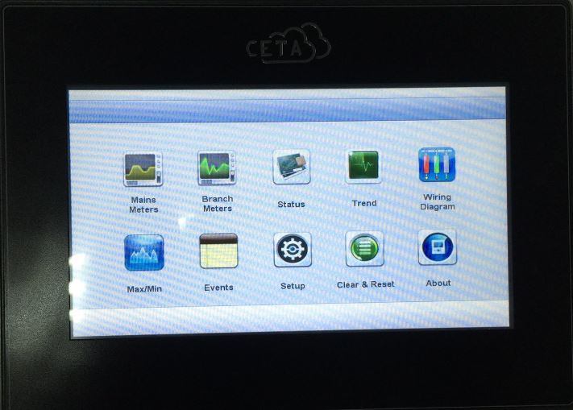
PMC-592 HMI‘s Front Panel Operation — Basic Info
Model: PMC-592-HMI-AE
Power Supply: 24VDC/ 10W
Operating Temp: 0-50℃
Firmware Version: V2.03

Slide 3
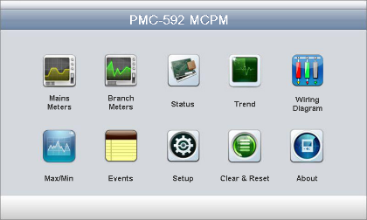
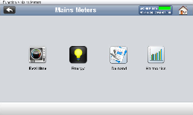
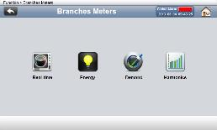
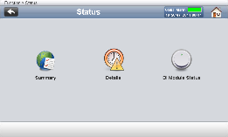
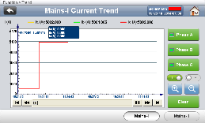
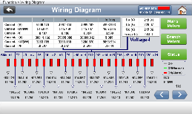
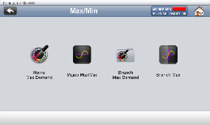
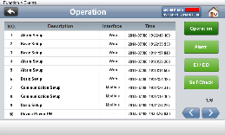
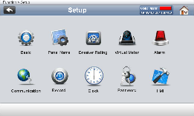
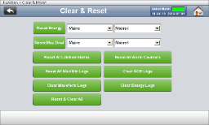
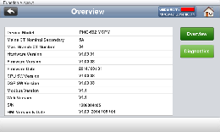
PMC-592 HMI‘s Front Panel Operation — Main Menu
Main Menu
10 functions
1. Mains Meters
2. Branch Meters
3. Status
4. Trend
5. Wiring Diagram
6. Max/ Min
7. Events
8. Setup
9. Clear & Reset
10. About

Slide 4
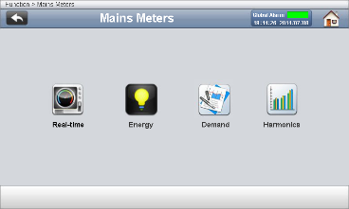
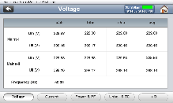
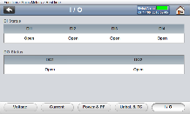
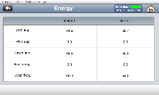
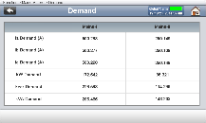
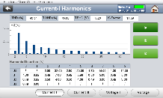
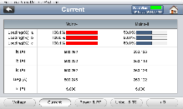
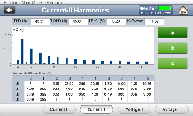
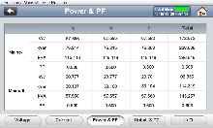

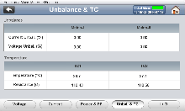
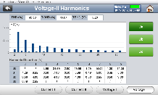
PMC-592 HMI‘s Front Panel Operation — Mains Meters
Mains Meters
Real-time
Energy
Demand
Harmonics

Slide 5
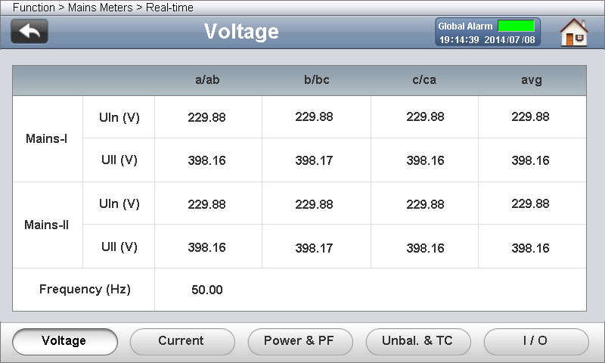
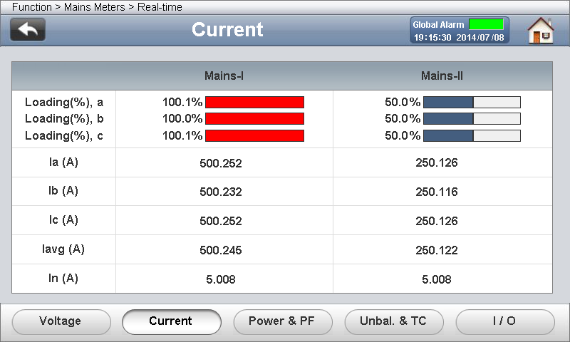
Mains Meters — Real-time
Measurements:
Two Mains Real-time Voltage
Frequency
Measurements:
I Per Phase and Average
Neutral Current
Loading
Notes: The calculation Method of Ia/b/c Loading is listed below:
Ia/Ib/Ic$\% Loading=\frac{Ia/Ib/Ic}{Breaker^{′}s Rated Capacity}$

Slide 6
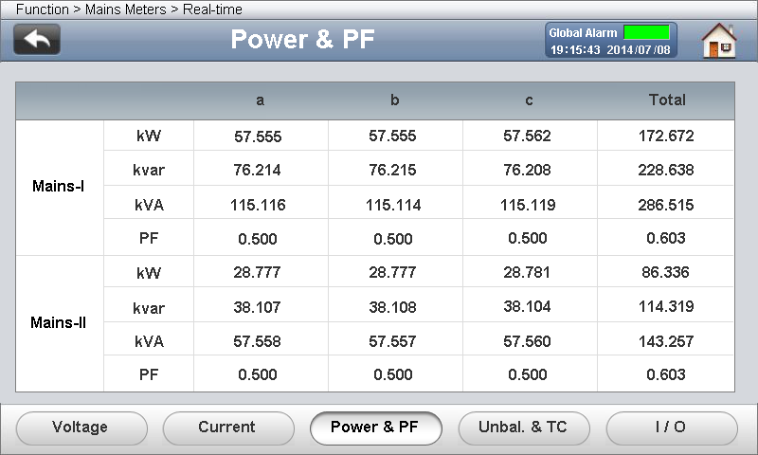
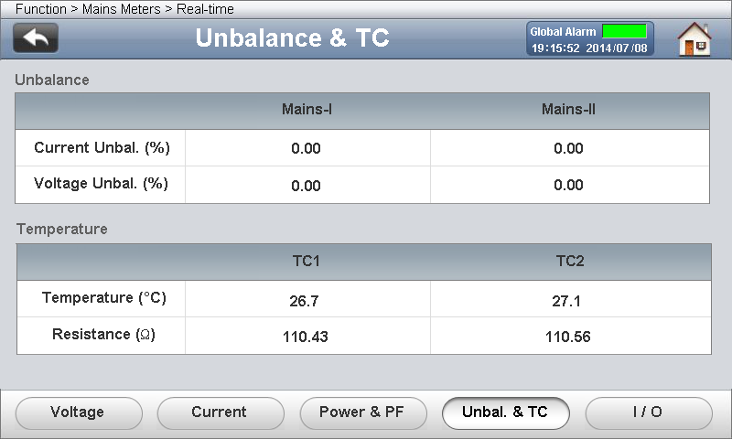

Mains Meters — Real-time
Measurements:
kW
kvar
kVA
PF
Measurements:
Unbalance
Calculation Method:
RTD1/2 Temperature and Resistance Value

Slide 7
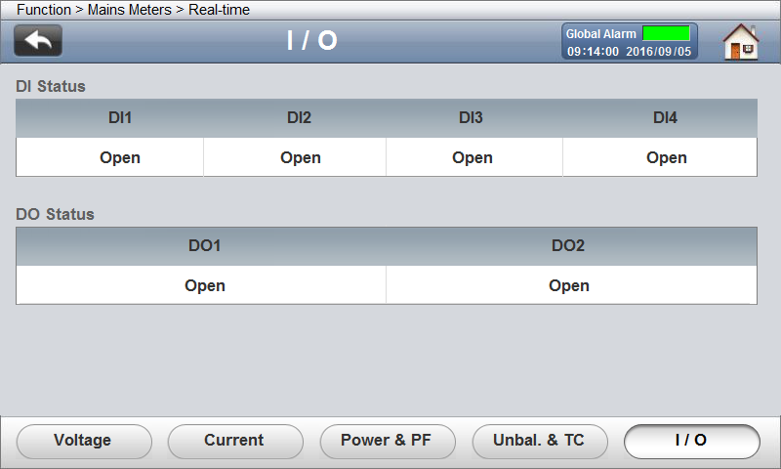
Mains Meters — Real-time
Measurements:
DI Status
DO Status

Slide 8
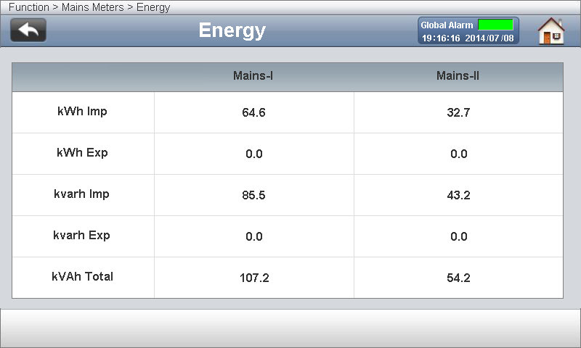
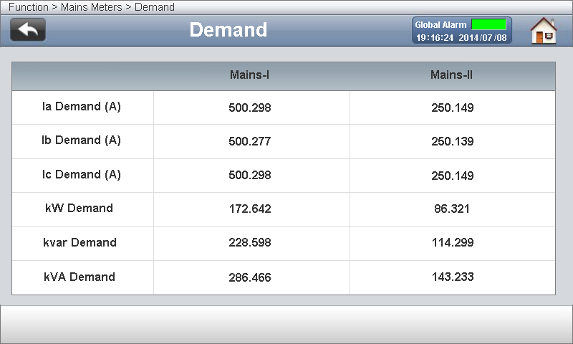
Mains Meters — Energy and Demand
Measurements:
Mains-I/II kWh Import
Mains-I/II kWh Export
Mains-I/II kvarh Import
Mains-I/II kvarh Export
Mains-I/II kVAh Total
Measurements:
Ia/Ib/Ic Demand
kW Demand
kvar Demand and kVA Demand
Demand is defined as the average power consumption over a fixed interval (usually 15 minutes).

Slide 9


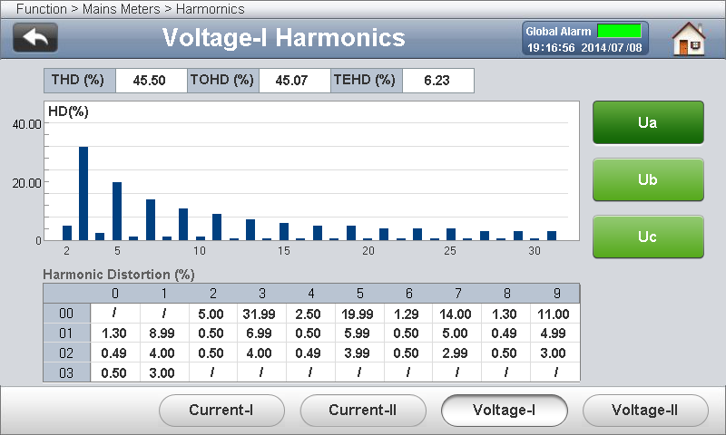

Mains Meters — Harmonics
Measurements:
Mains-I/II Current 2nd to 31st Harmonic Voltage 2nd to 31st Harmonic, Current THD/TOHD/TEHD and Voltage THD/TOHD/TEHD.

Slide 10
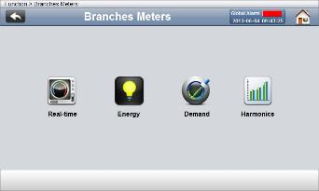
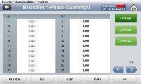
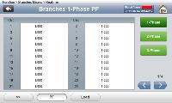
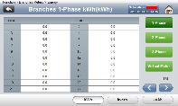
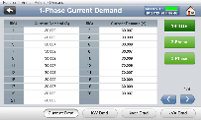
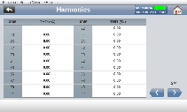
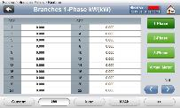
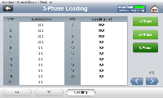
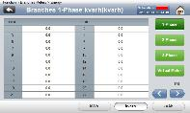
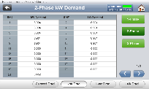
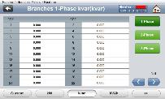
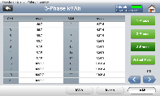
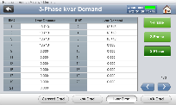
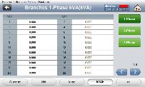
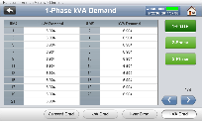
PMC-592 HMI‘s Front Panel Operation — Branch Meters
Branch Meters
Real-time
Energy
Demand
Harmonics

Slide 11
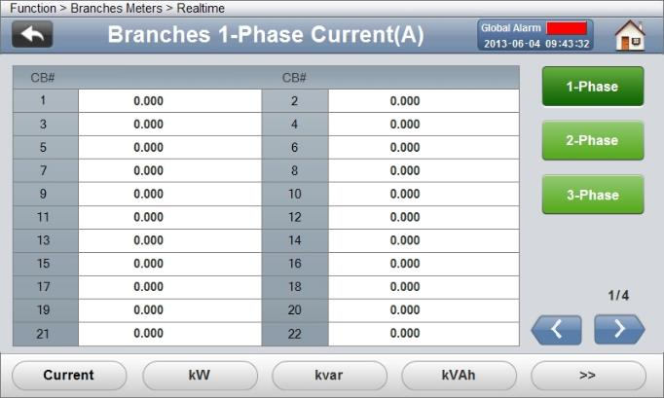
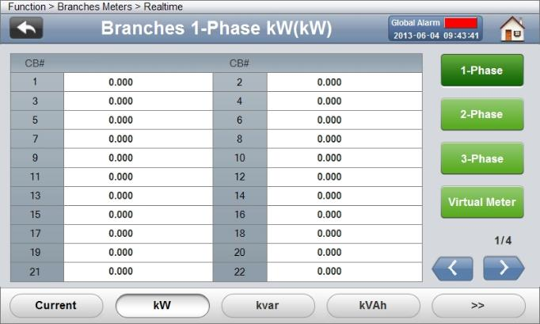
Branch Meters — Real-time
Measurements:
1-Phase SM1 to SM84 Current
2-Phase SM1 to SM42 Current
3-Phase SM1 to SM28 Current
Measurements:
1-Phase SM1 to SM84 kW
2-Phase SM1 to SM42 kW
3-Phase SM1 to SM28 kW
VM1 to VM10 kW

Slide 12


Branch Meters — Real-time
Measurements:
1-Phase SM1 to SM84 kvar
2-Phase SM1 to SM42 kvar
3-Phase SM1 to SM28 kvar
Measurements:
1-Phase SM1 to SM84 kVA
2-Phase SM1 to SM42 kVA
3-Phase SM1 to SM28 kVA

Slide 13
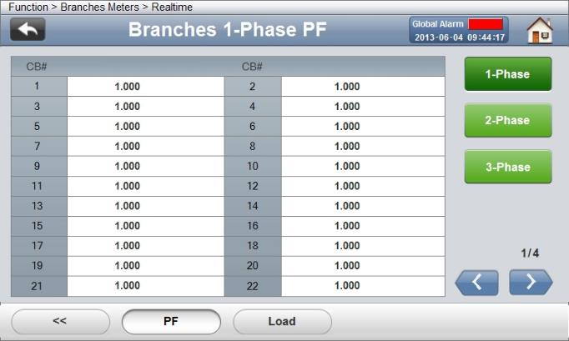
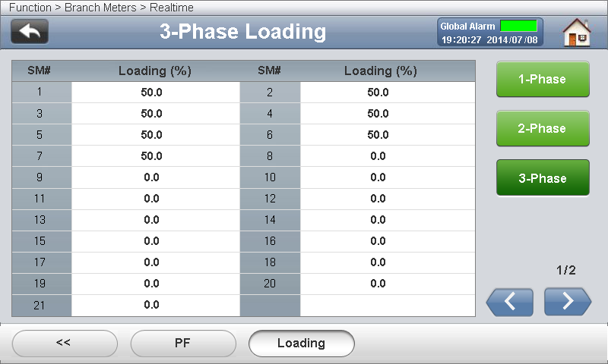
Branch Meters — Real-time
Measurements:
1-Phase SM1 to SM84 PF
2-Phase SM1 to SM42 PF
3-Phase SM1 to SM28 PF
Measurements:
1-Phase SM1 to SM84 Current Loading Rate
2-Phase SM1 to SM42 Current Loading Rate
3-Phase SM1 to SM28 Current Loading Rate

Slide 14


Branch Meters — Energy
Measurements:
1-Phase SM1 to SM84 kWh
2-Phase SM1 to SM42 kWh
3-Phase SM1 to SM28 kWh
VM1 to VM10 kWh
Measurements:
1-Phase SM1 to SM84 kvarh
2-Phase SM1 to SM42 kvarh
3-Phase SM1 to SM28 kvarh
VM1 to VM10 kvarh

Slide 15


Branch Meters — Energy and Harmonics
Measurements:
1-phase SM1 to SM84 kVAh
2-phase SM1 to SM42 kVAh
3-phase SM1 to SM28 kVAh
VM1 to VM10 kVAh
Measurements:
SM1 to SM84 Current THD

Slide 16


Branch Meters — Demand
Measurements:
1-Phase SM1 to SM84 Current Demand
2-Phase SM1 to SM42 Current Demand
3-Phase SM1 to SM28 Current Demand
Measurements:
1-Phase SM1 to SM84 kW Demand
2-Phase SM1 to SM42 kW Demand
3-Phase SM1 to SM28 kW Demand

Slide 17


Branch Meters — Demand
Measurements:
1-Phase SM1 to SM84 kvar Demand
2-Phase SM1 to SM42 kvar Demand
3-Phase SM1 to SM28 kvar Demand
Measurements:
1-Phase SM1 to SM84 kVA Demand
2-Phase SM1 to SM42 kVA Demand
3-Phase SM1 to SM28 kVA Demand

Slide 18











PMC-592 HMI‘s Front Panel Operation — Status
Status
Summary
Details
DI Module Status

Slide 19

Status — Summary
Measurements:
Global instantaneous type alarm status summary
Global stability state of alarm summary

Slide 20


Status — Details
Measurements:
Displays Instantaneous and Latched Alarm
Mains-I Global Alarm
Mains-I Voltage Alarm
Mains-I Current Alarm
Mains-I Power Alarm
Mains-I Harmonics Alarm
Mains-I Unbalance Alarm
Measurements:
Displays Instantaneous and Latched Alarm
Mains-II Global Alarm
Mains-II Voltage Alarm
Mains-II Current Alarm
Mains-II Power Alarm
Mains-II Harmonics Alarm
Mains-II Unbalance Alarm

Slide 21


Status — Details
Measurements:
Displays Instantaneous and Latched Alarm
SM1 to SM84 Alarm Status
Measurements:
Displays Instantaneous and Latched Alarm
Temperature Alarm Status
DI Alarm Status

Slide 22

Status — Details
Measurements:
Mains Alarm Count
SM1 to SM84 Alarm Count

Slide 23




Status — DI Module Status
Measurements:
DI Module On-Off Status

Slide 24
















PMC-592 HMI‘s Front Panel Operation — Max/ Min
Max/Min
Mains Max Demand
Mains Max/Min
Branch Max Demand
Branch Max

Slide 25

Max/ Min — Mains Max Demand
Measurements:
Mains-I/II Max Demand of last month, this month and History
Current Max Demand
kW Max Demand
kvar Demand
kVA Demand

Slide 26



Max/ Min — Mains Max/ Min
Measurements:
Mains-I/II Max/ Min Data and Temperature of last month, this month and History

Slide 27




Max/ Min — Branch Max Demand
Measurements:
SM1 to SM84 Max Demand of last month, this month and History
Current Max Demand kW Max Demand
kvar Demand kVA Demand

Slide 28




Max/ Min — Branch Max
Measurements:
SM1 to SM84 Max Demand of last month, this month and History
Current Max Data kW Max Data
kvar Data kVA Data

Slide 29



Max/ Min — Branch Max
Measurements:
PF Max Data
Loading Max Data
THD Max Data

Slide 30











PMC-592 HMI‘s Front Panel Operation — Setup
Setup
Password: 000000
1. Basic Setup
2. Panel Name
3. Breaker Rating
4. Virtual Meter Setup
5. Alarm
6. Communication Setup
7. Record
8. Clock
9. Password
10. HMI

Slide 31






Setup— Basic Setup
Basic Setup
Basic Setup and Mains Ratio
Branch CT Ratio

Slide 32



Setup— Basic Setup
Measurements:
System Basic Settings

Slide 33



Setup— Basic Setup
Measurements:
Branch CT Ratio Settings

Slide 34


Setup— Panel Name and Breaker Rating
Measurements:
Panel Name Settings
Device Name Settings
Measurements:
Mains I/II Breaker Rating Settings

Slide 35













PMC-592 HMI‘s Front Panel Operation — Alarm Setup
Alarm Setup
1. Current
2. Current Dmd
3. Power
4. Power Dmd
5. Voltage
6. Frequency
6. Harmonics
7. Unbalance
7. PF
8. DI
9. Temperature
10. Phase Reversal & Loss
11. Transient

Slide 36




Setup— Alarm Setup
Measurements:
Current Alarm Settings
Power Alarm Settings

Slide 37




Setup— Alarm Setup
Measurements:
Voltage Alarm Settings Frequency Alarm Settings
Harmonics Alarm Settings Unbalance Alarm Settings

Slide 38




Setup— Alarm Setup
Measurements:
PF Alarm Settings DI Alarm Settings
Temperature Alarm Settings Phase Reversal & Loss Alarm Settings

Slide 39

Setup— Alarm Setup
Measurements:
Dip/Swell Settings

Slide 40


Setup— Virtual Meter and Communication Setup
Measurements:
VM 1 to VM 10 Virtual Meters Settings
Measurements:
P1 Communication Settings
P2 Communication Settings
P3 Communication Settings
Extension DI Module Settings

Slide 41


Setup— Record and Clock Setup
Measurements:
WFR Settings
Energy Log Settings
Measurements:
Device Time Settings
SNTP Time Sync Settings

Slide 42


Setup— Record and Clock Setup
Measurements:
Device Password Settings
Measurements:
HMI Brightness Settings
Backlight Time Settings
HMI Communication Settings

