Slide 1
PMC-592 Web Interface
September 29, 2016

Slide 2
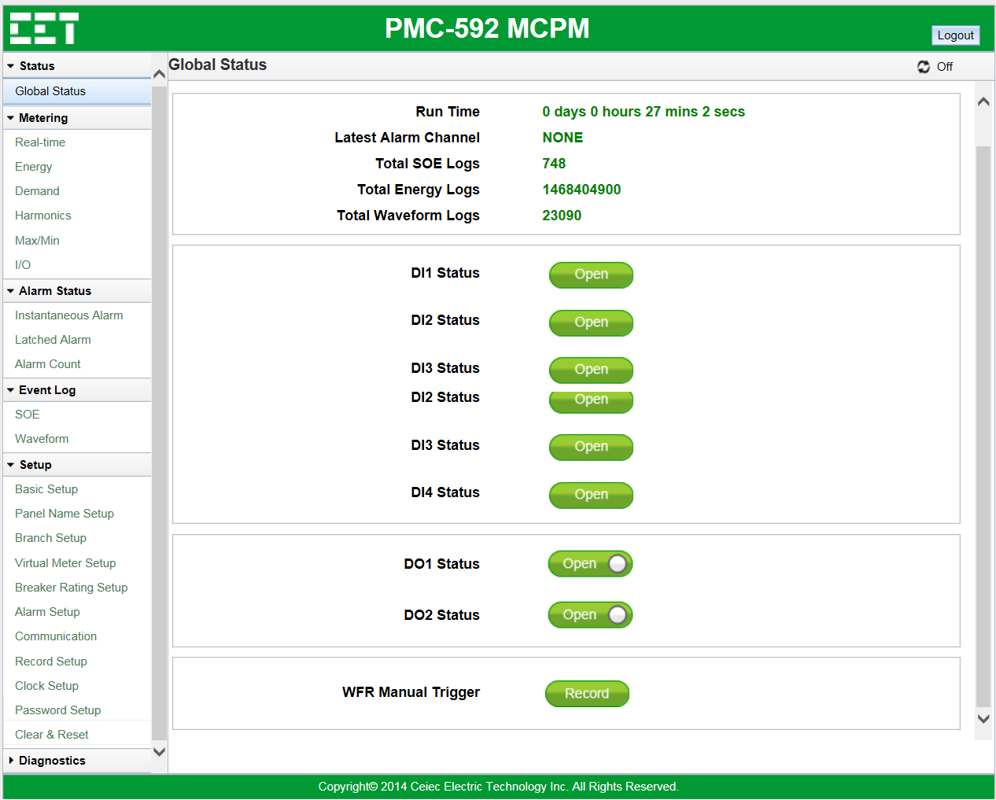
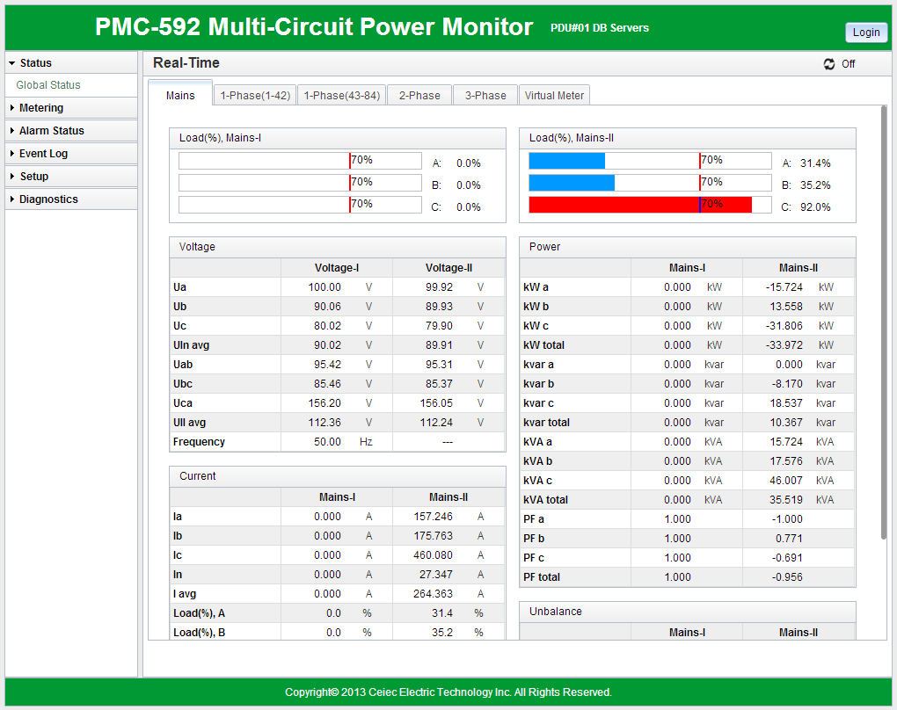
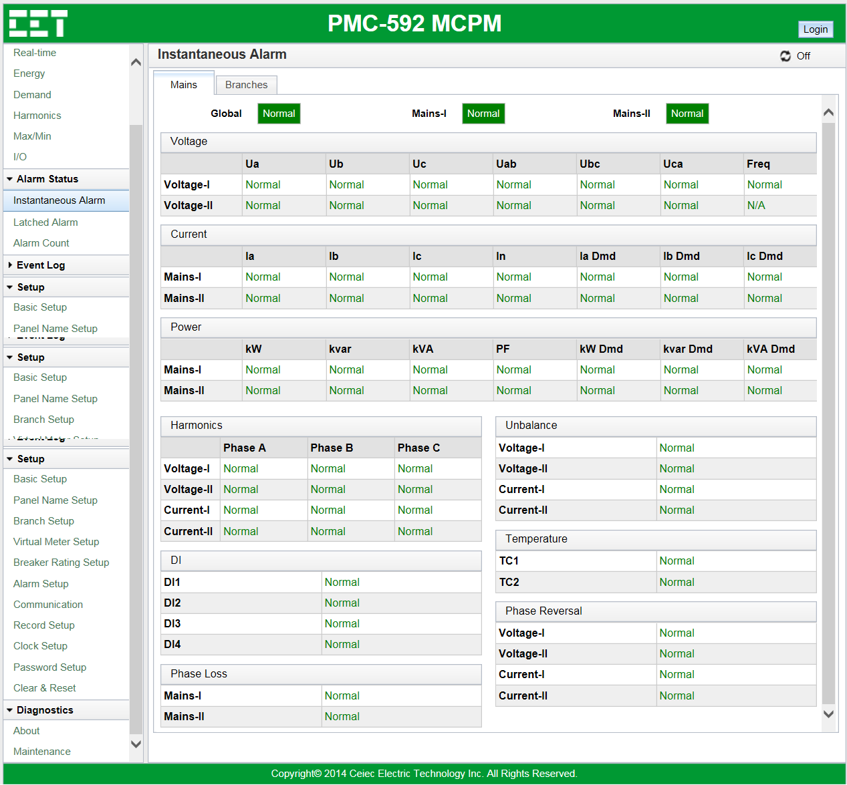
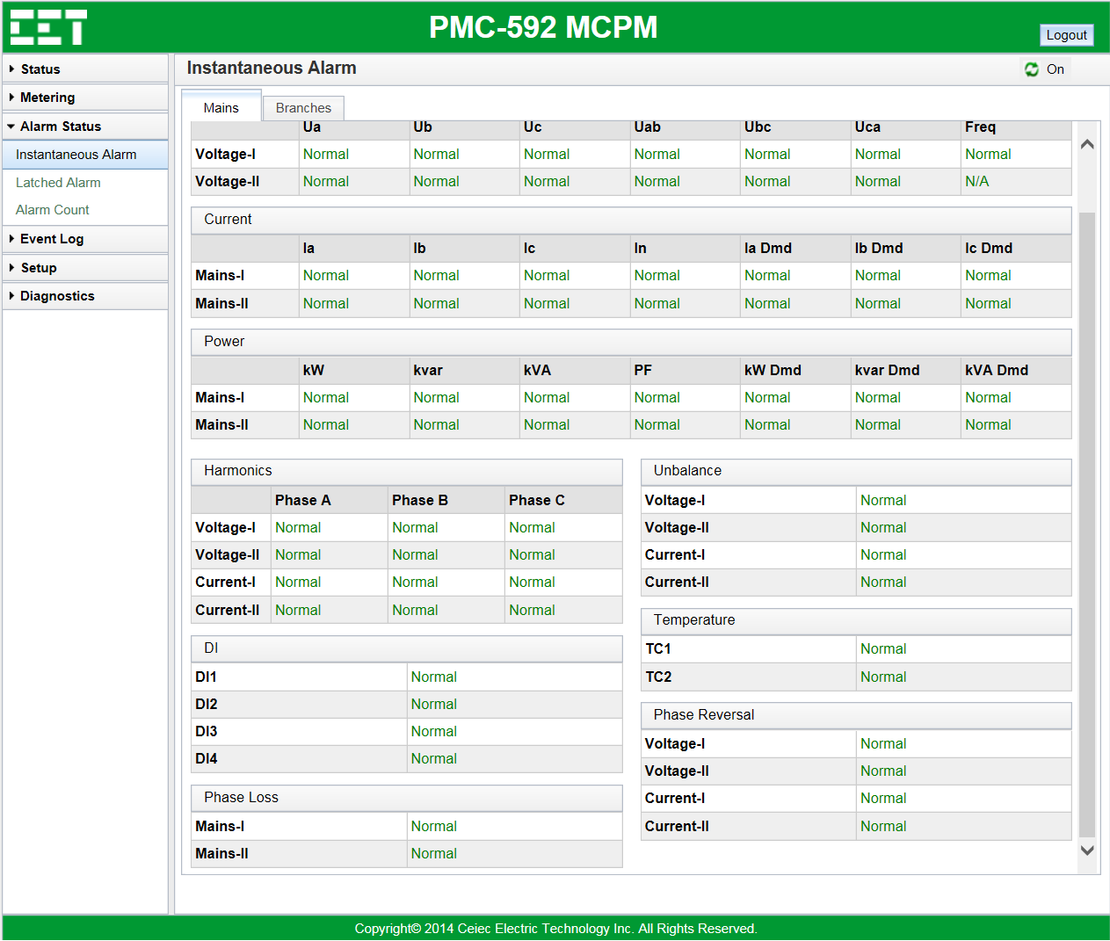
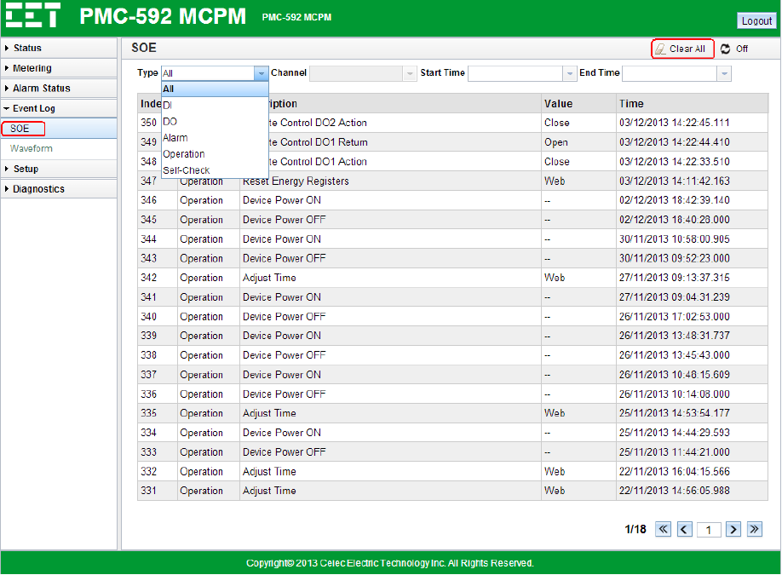
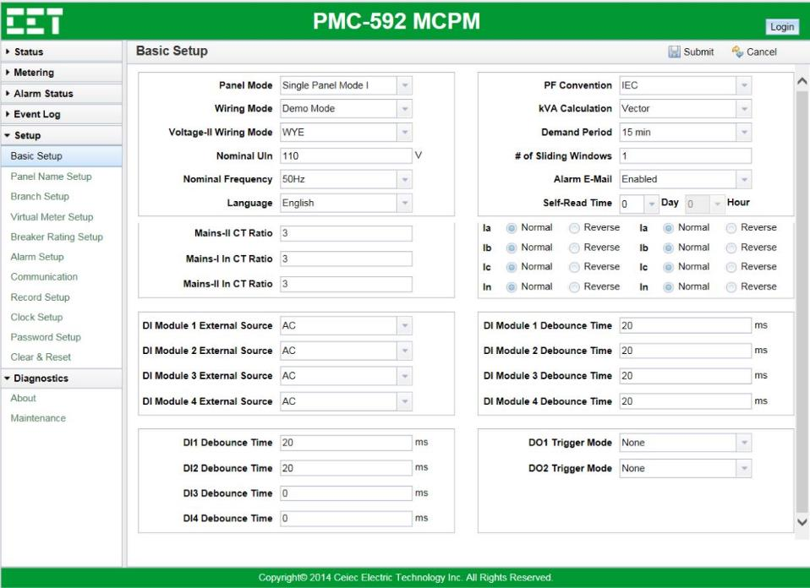
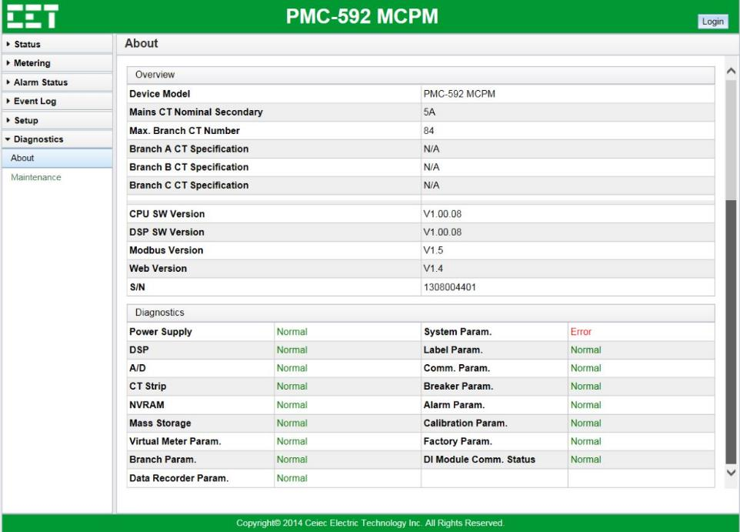
Overview
Main Menu
6 functions
1. Status
2. Metering
3. Alarm Status
4. Event Log
5. Setup
6. Diagnostics

Slide 3
Status— Global Status
Enter the IP Address of the PMC-592 in the Address area of your Internet Explorer.
Default User Name: user
Default Password: 0000
Measurements:
Run Time
Latest Alarm Channel
Event Logs
DI Status
DO Status

Slide 4


Metering — Real-Time — Mains
Measurements:
Mains I/II Voltage
Voltage
Frequency
Mains I/II Current
I Per Phase and Average
Neutral Current
Loading
Mains I/II Power
kW
kvar
kVA
PF
Mains I/II Unbalance
Mains I/II RTD1/2 Temperature
Ia/Ib/Ic$\% Loading=\frac{Ia/Ib/Ic}{Breaker^{′}s Rated Capacity}$

Slide 5
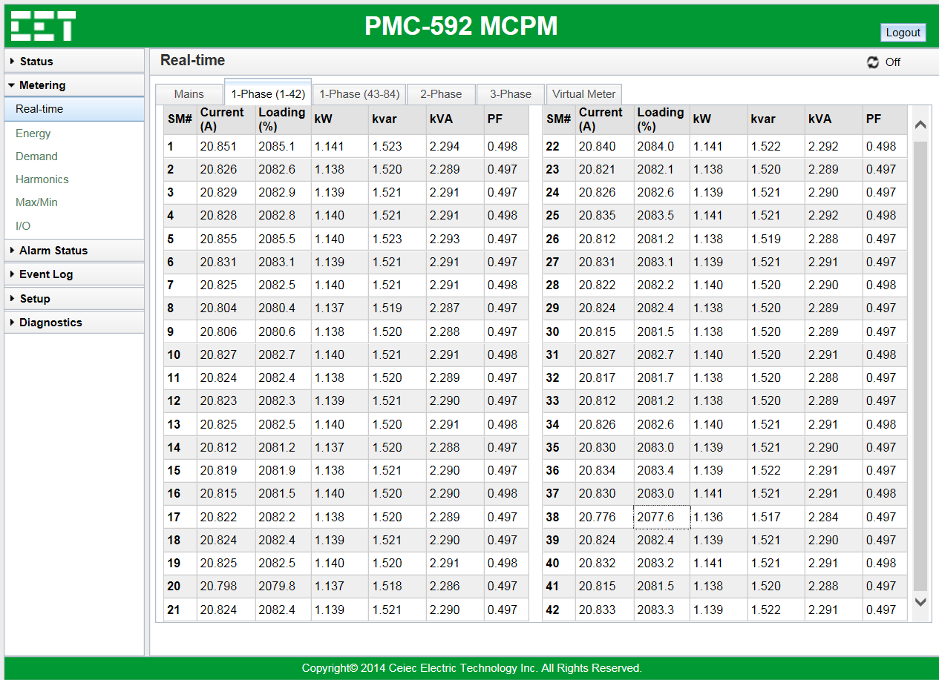
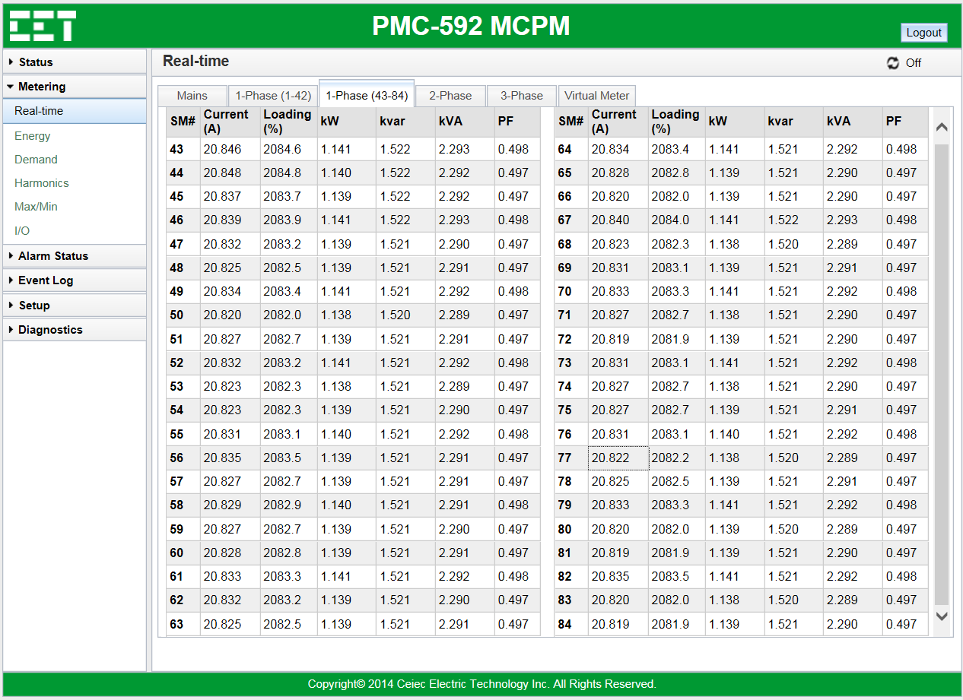
Metering — Real-Time — Branches
Measurements:
1-Phase SM1 to SM42 Current
1-Phase SM1 to SM42 Loading
1-Phase SM1 to SM42 kW
1-Phase SM1 to SM42 kvar
1-Phase SM1 to SM42 kVA
1-Phase SM1 to SM42 PF
Measurements:
1-Phase SM43 to SM84 Current
1-Phase SM43 to SM84 Loading
1-Phase SM43 to SM84 kW
1-Phase SM43 to SM84 kvar
1-Phase SM43 to SM84 kVA
1-Phase SM43 to SM84 PF

Slide 6

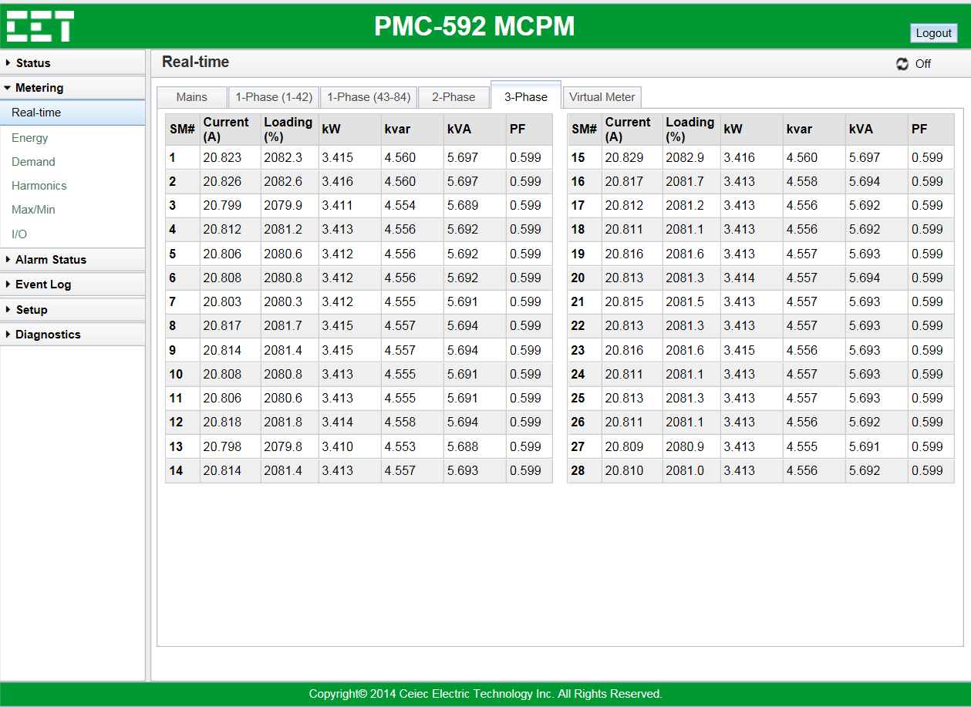
Metering — Real-Time — Branches
Measurements:
2-Phase SM1 to SM42 Current
2-Phase SM1 to SM42 Loading
2-Phase SM1 to SM42 kW
2-Phase SM1 to SM42 kvar
2-Phase SM1 to SM42 kVA
2-Phase SM1 to SM42 PF
Measurements:
3-Phase SM1 to SM28 Current
3-Phase SM1 to SM28 Loading
3-Phase SM1 to SM28 kW
3-Phase SM1 to SM28 kvar
3-Phase SM1 to SM28 kVA
3-Phase SM1 to SM28 PF

Slide 7
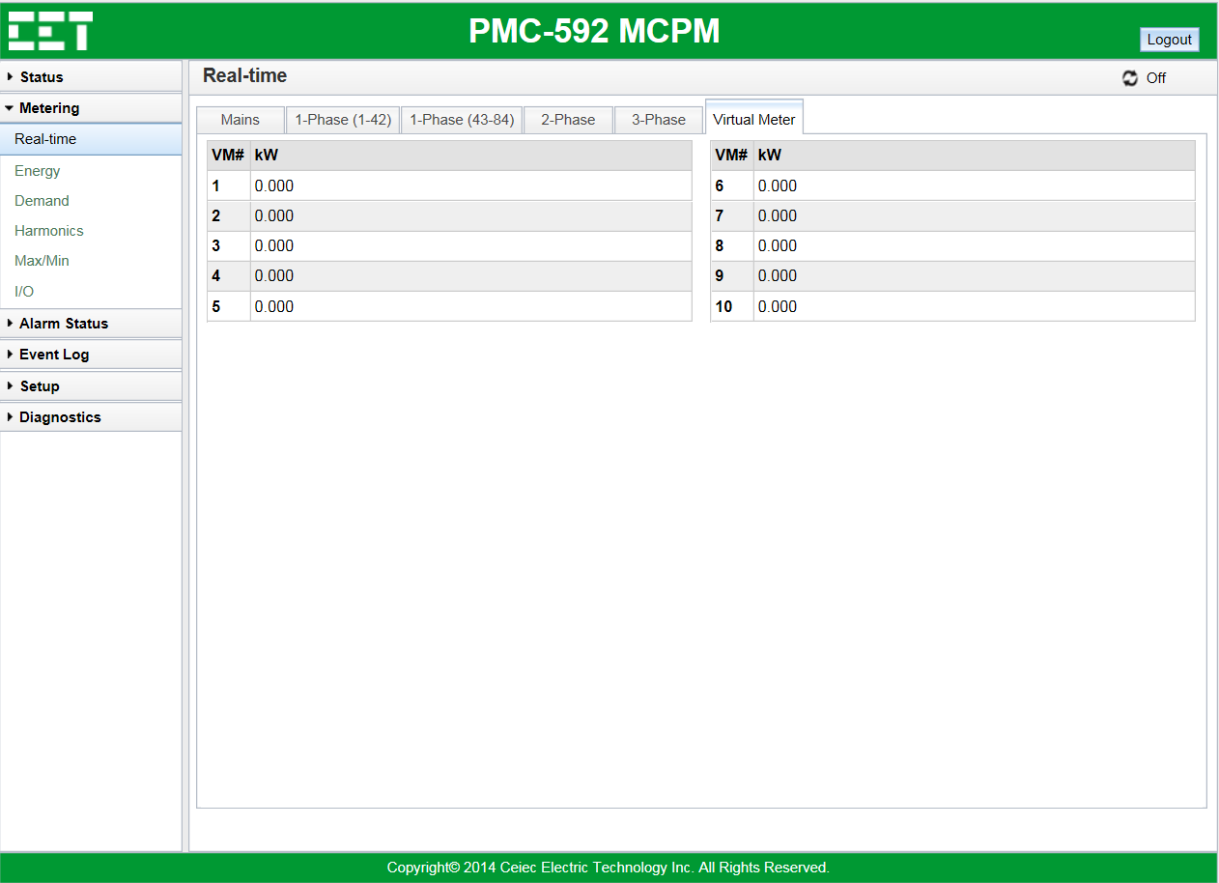
Metering — Real-Time — Virtual Meter
Measurements:
VM1 to VM10 kW

Slide 8
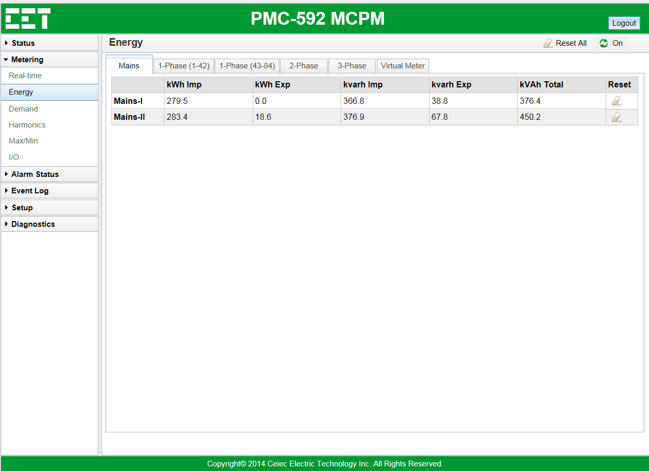
Metering — Energy — Mains
Measurements:
Mains I/II kWh Imp
Mains I/II kWh Exp
Mains I/II kvarh Imp
Mains I/II kvarh Exp
Mains I/II kVAh Total
Reset:
Click the broom icon of Reset All can clear all energy measurements.

Slide 9
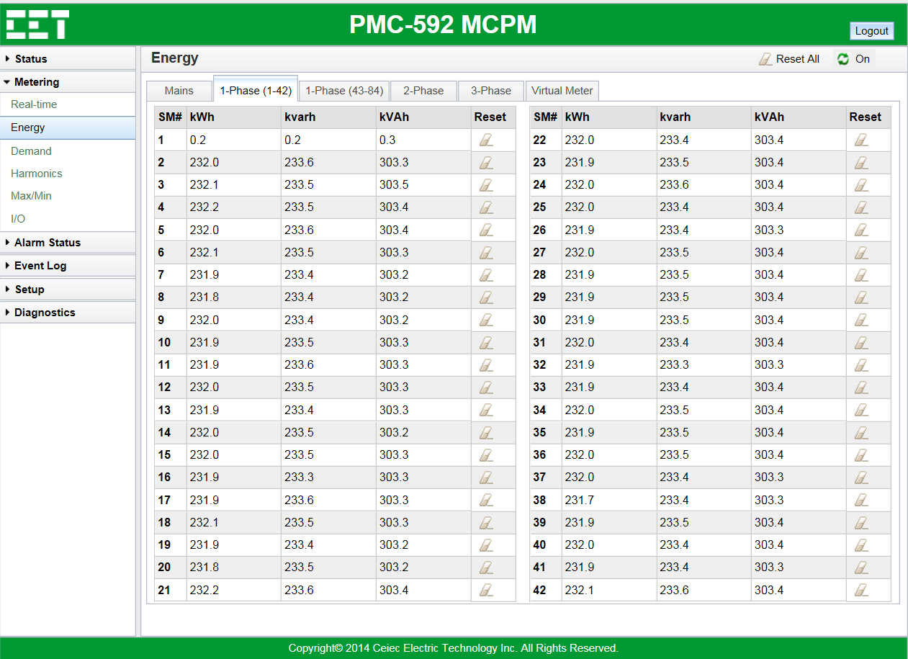
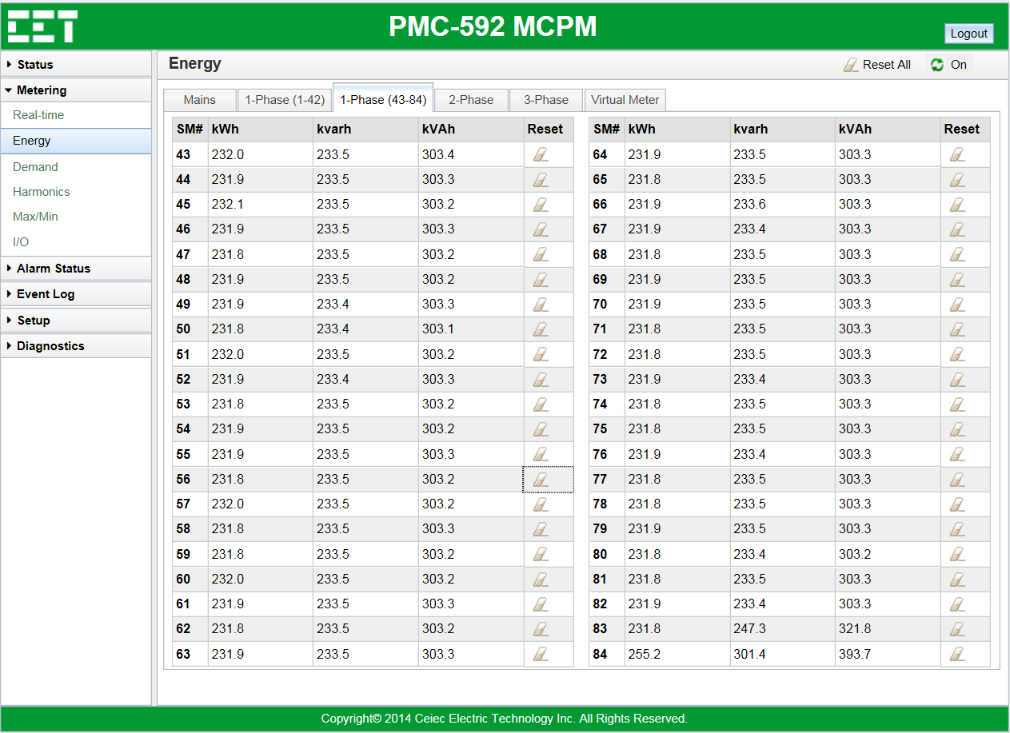
Metering — Energy — Branches
Measurements:
1-Phase SM1 to SM42 kWh
1-Phase SM1 to SM42 kvarh
1-Phase SM1 to SM42 kVAh
Measurements:
1-Phase SM43 to SM84 kWh
1-Phase SM43 to SM84 kvarh
1-Phase SM43 to SM84 kVAh

Slide 10
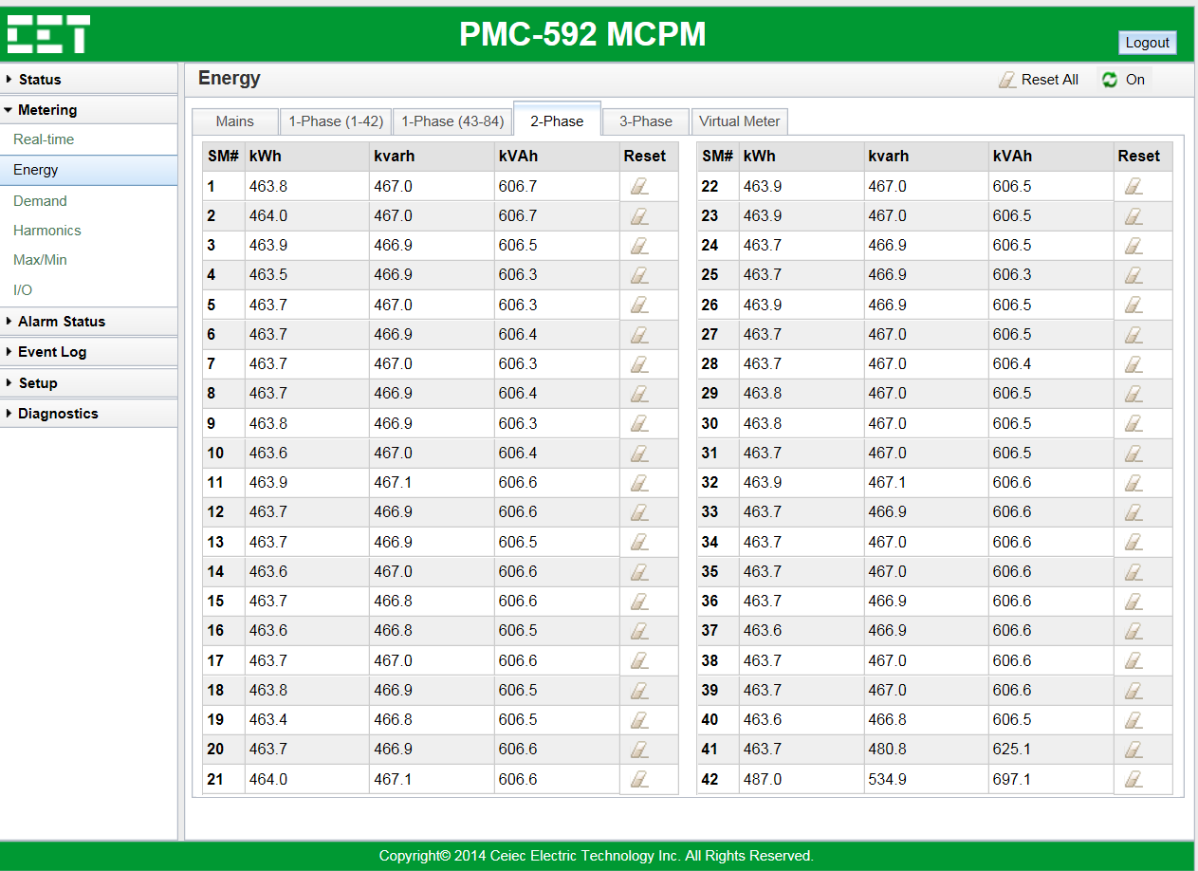
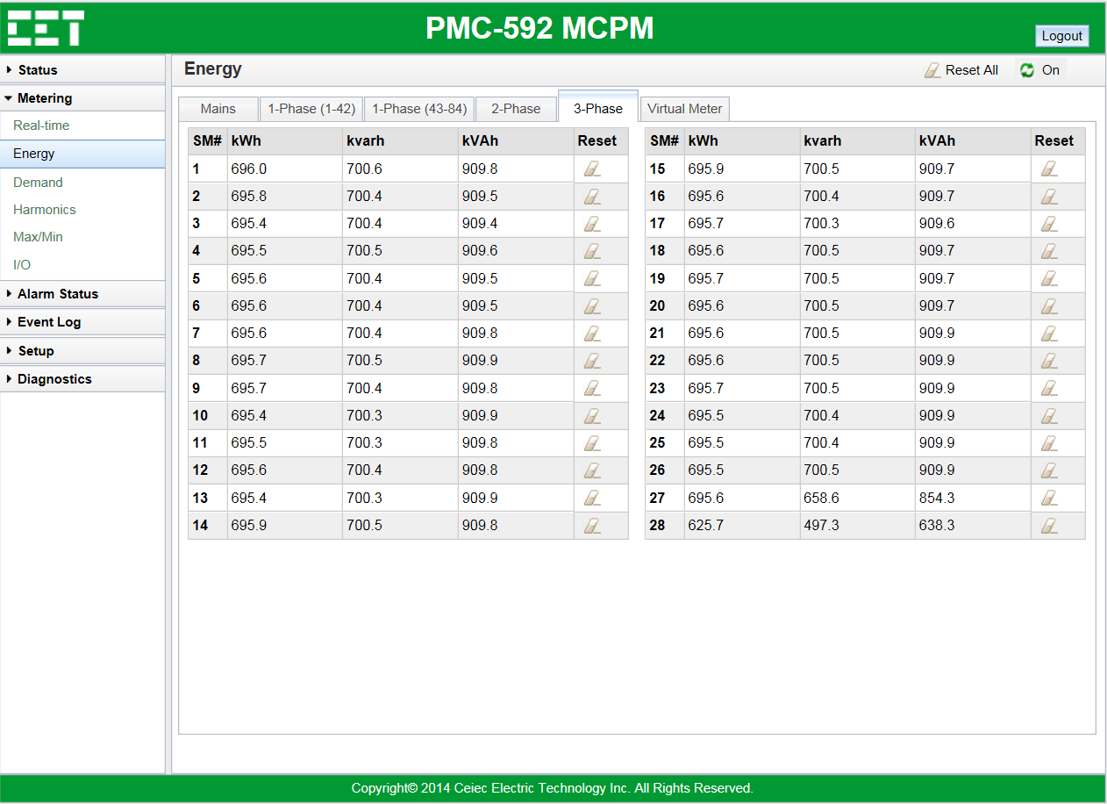
Metering — Energy — Branches
Measurements:
1-Phase SM1 to SM42 kWh
1-Phase SM1 to SM42 kvarh
1-Phase SM1 to SM42 kVAh
Measurements:
1-Phase SM1 to SM28 kWh
1-Phase SM1 to SM28 kvarh
1-Phase SM1 to SM28 kVAh

Slide 11
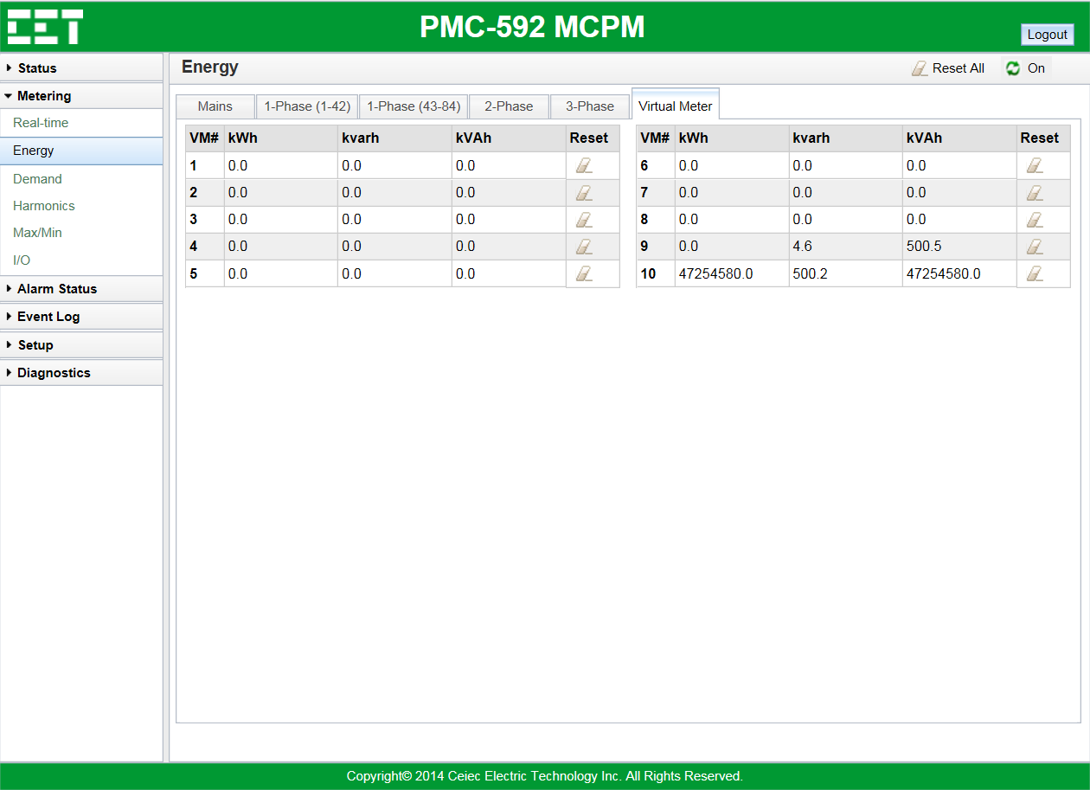
Metering — Energy — Virtual Meter
Measurements:
VM1 to VM10 kWh

Slide 12
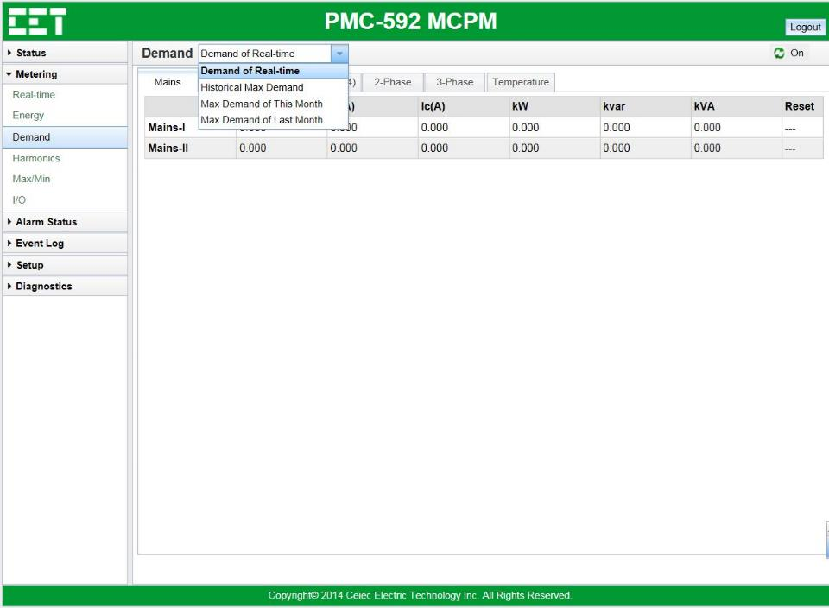
Metering — Demand — Mains
Demand Type:
Click the drop-down button to choose the Demand type you want to view.
Present Demand
Historical Max Demand
Max Demand of This Month
Max Demand of Last Month
Measurements:
Ia/Ib/Ic
kW
kvar
kVA

Slide 13
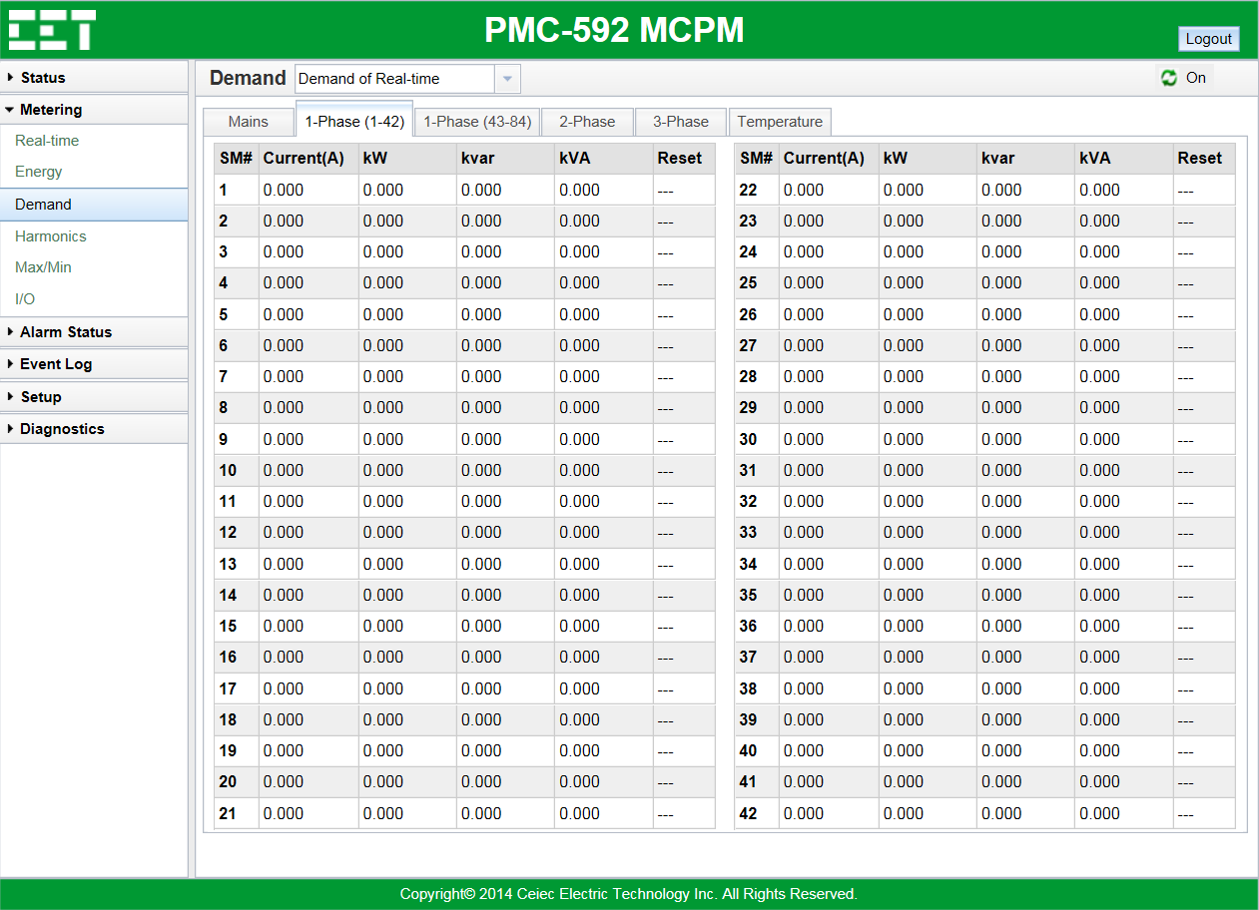
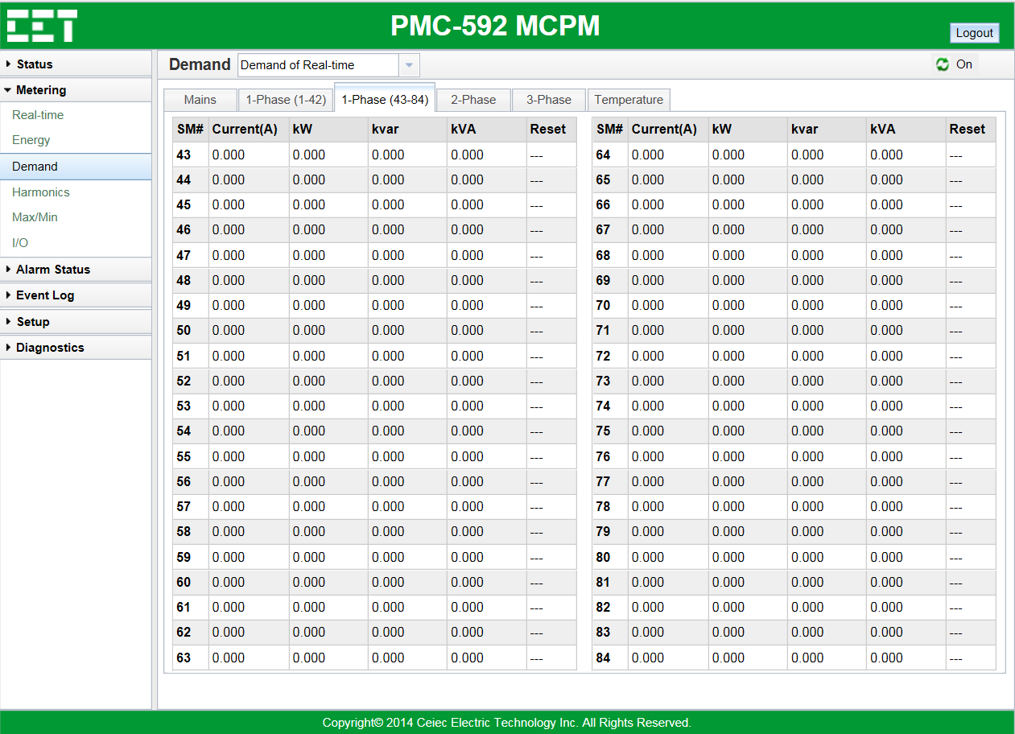
Metering — Demand — Branches
Measurements:
1-Phase SM1 to SM42 Current Demand
1-Phase SM1 to SM42 kW Demand
1-Phase SM1 to SM42 kvar Demand
1-Phase SM1 to SM42 kVA Demand
Measurements:
1-Phase SM43 to SM84 Current Demand
1-Phase SM43 to SM84 kW Demand
1-Phase SM43 to SM84 kvar Demand
1-Phase SM43 to SM84 kVA Demand

Slide 14
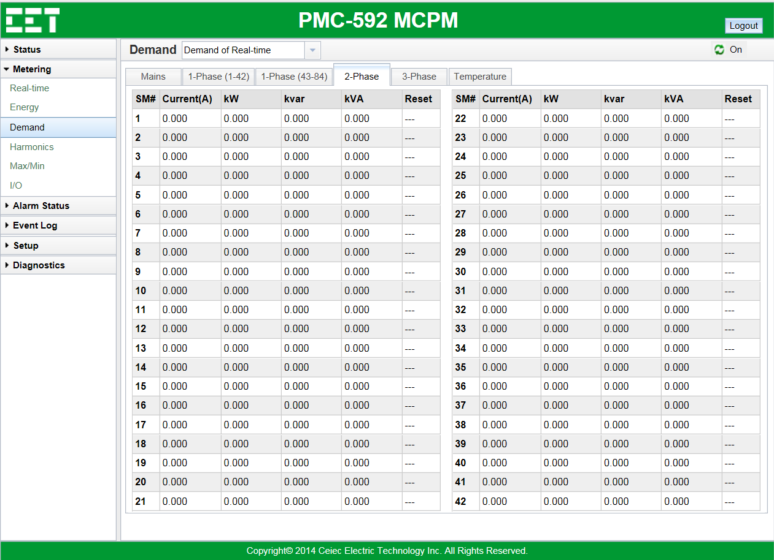
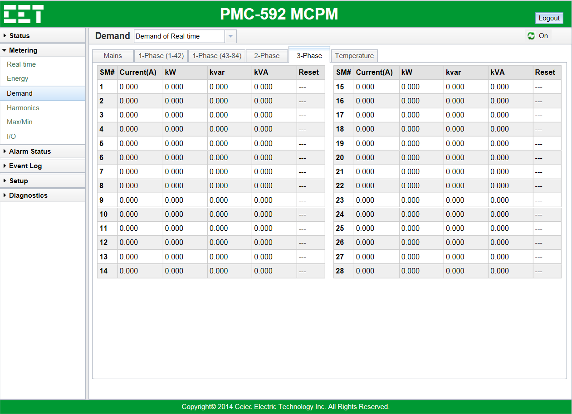
Metering — Demand — Branches
Measurements:
2-Phase SM1 to SM42 Current Demand
2-Phase SM1 to SM42 kW Demand
2-Phase SM1 to SM42 kvar Demand
2-Phase SM1 to SM42 kVA Demand
Measurements:
3-Phase SM1 to SM28 Current Demand
3-Phase SM1 to SM28 kW Demand
3-Phase SM1 to SM28 kvar Demand
3-Phase SM1 to SM28 kVA Demand

Slide 15
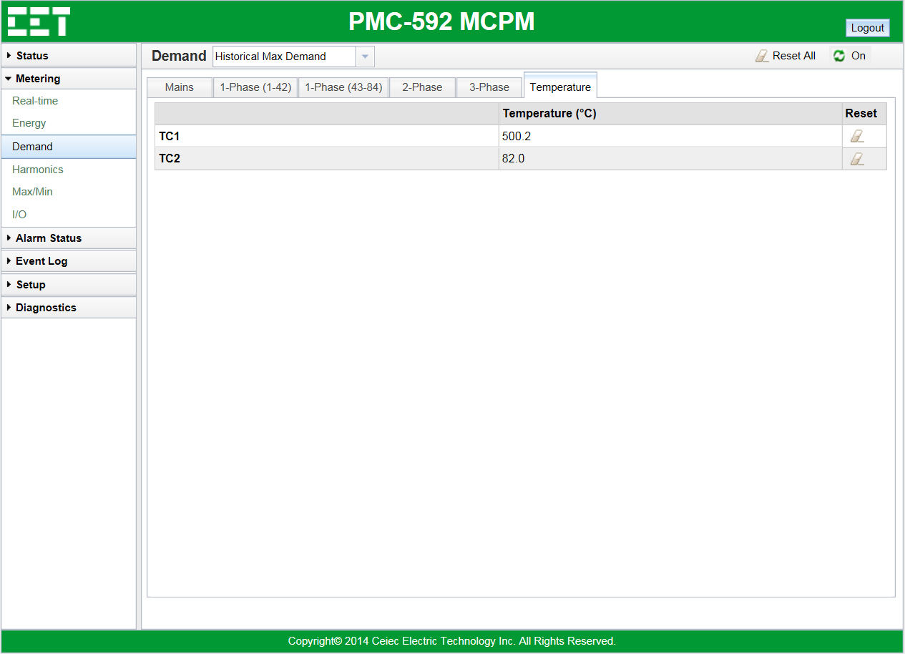
Metering — Demand — Temperature
Measurements:
RTD1/RTD2 Temperature Demand

Slide 16
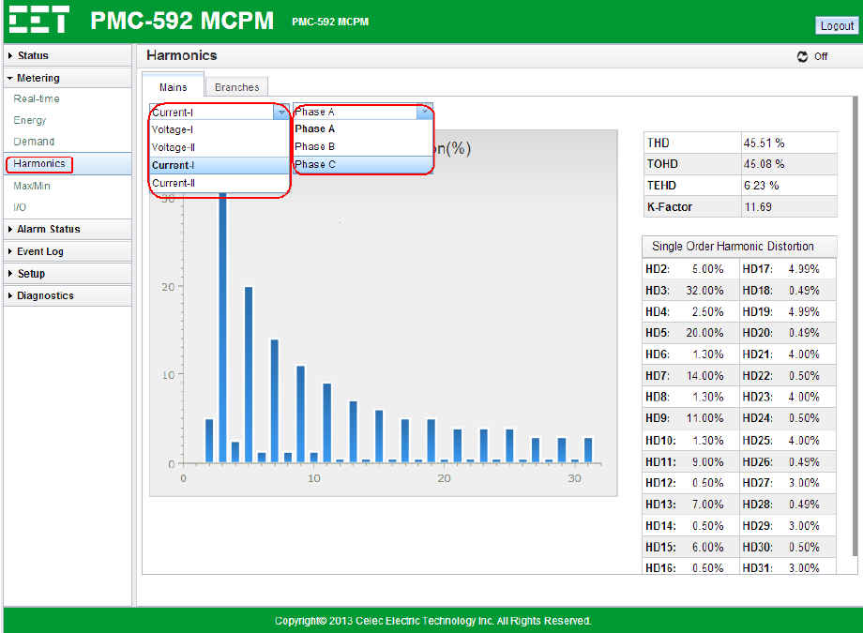
Metering — Harmonics — Mains
Measurements:
Mains-I/II Current 2nd to 31st Harmonic
Mains-I/II Voltage 2nd to 31st Harmonic
Mains-I/II Current THD/TOHD/TEHD
Mains-I/II Voltage THD/TOHD/TEHD

Slide 17
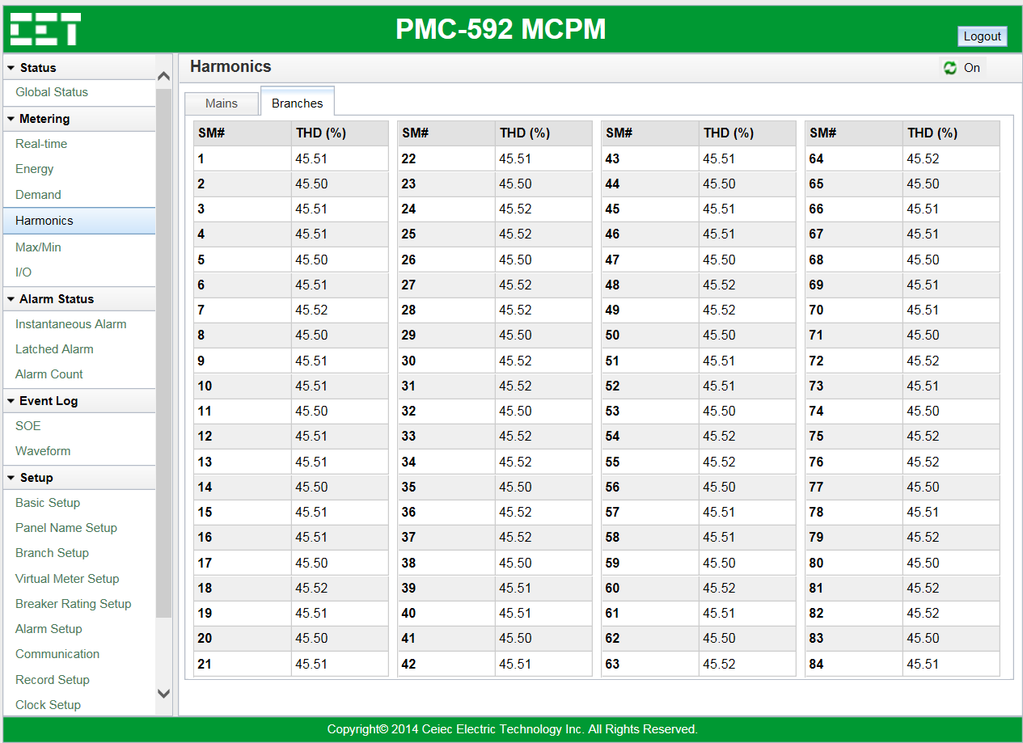
Metering — Harmonics — Branches
Measurements:
SM1 to SM84 Current THD

Slide 18
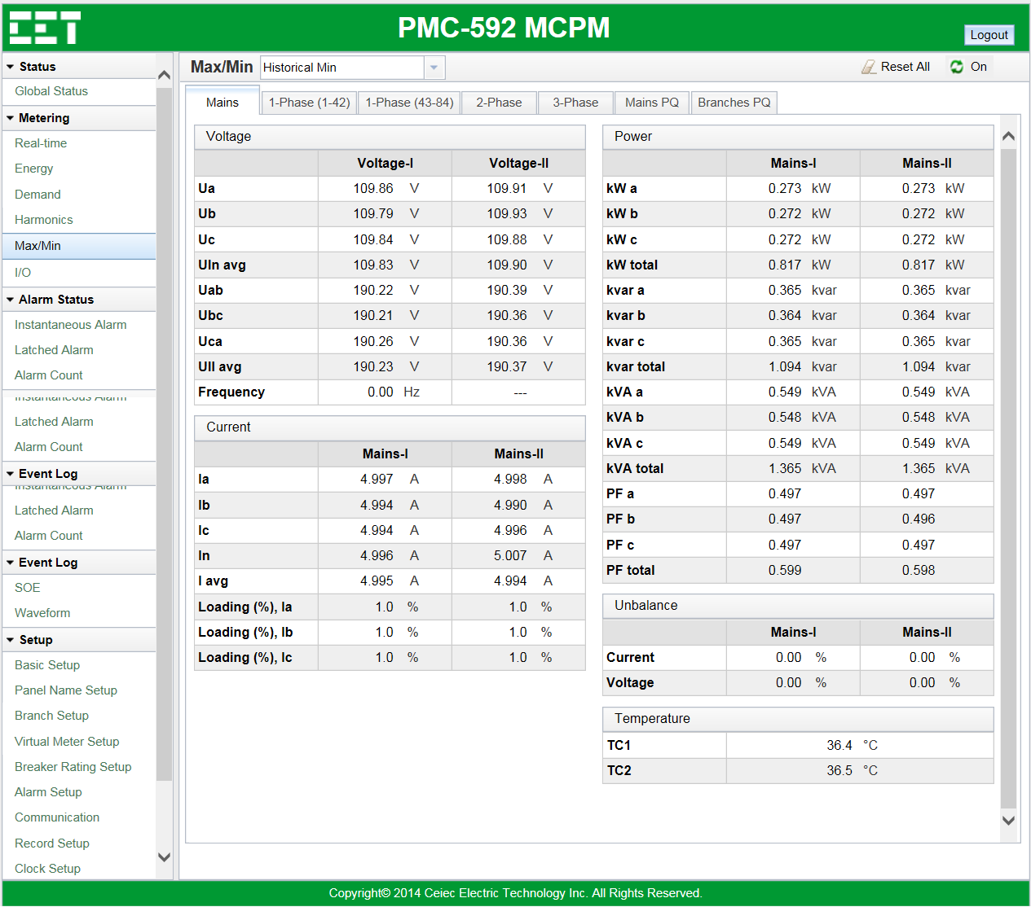
Metering — Max/Min — Mains
Max/Min Type:
Click the drop-down button to choose the max/min type you want to view
Historical Max
Historical Min
Max of This Month
Max of Last Month
Min of This Month
Min of Last Month.
Measurements:
Voltage Max/Min
Current Max/Min
Power Max/Min
Power Voltage Unbalance Max/Min
Current Unbalance Max/Min
RTD1/RTD2 Max/Min

Slide 19
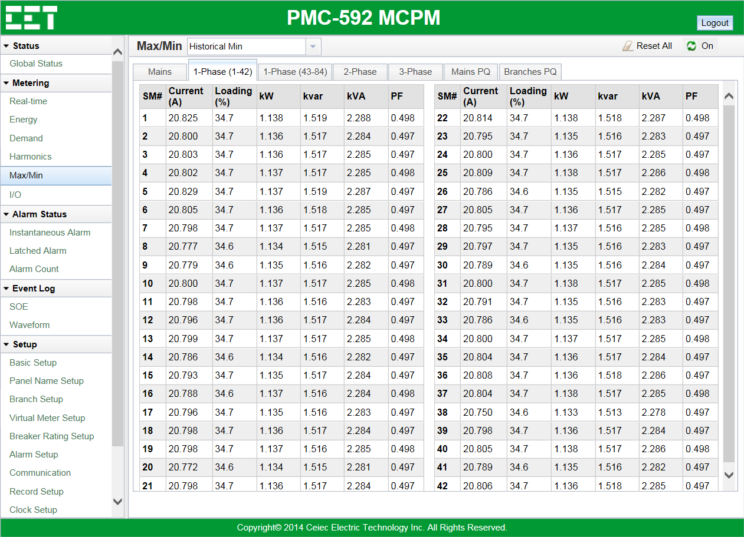
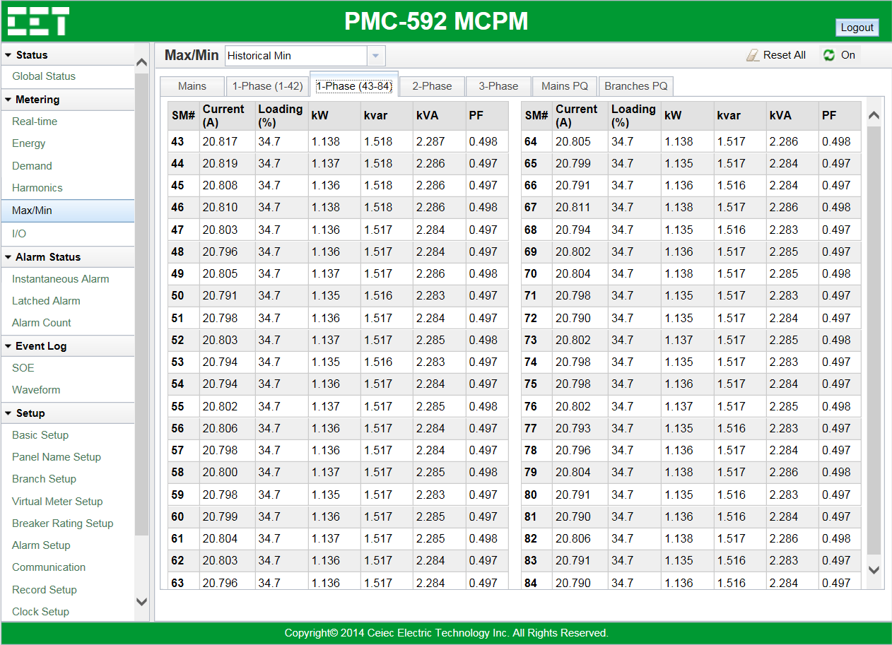
Metering — Max/Min — Branches
Measurements:
1-Phase SM1 to SM42 Current Max/Min
1-Phase SM1 to SM42 Loading Max/Min
1-Phase SM1 to SM42 kW Max/Min
1-Phase SM1 to SM42 kvar Max/Min
1-Phase SM1 to SM42 kVA Max/Min
1-Phase SM1 to SM42 PF Max/Min
Measurements:
1-Phase SM43 to SM84 Current Max/Min
1-Phase SM43 to SM84 Loading Max/Min
1-Phase SM43 to SM84 kW Max/Min
1-Phase SM43 to SM84 kvar Max/Min
1-Phase SM43 to SM84 kVA Max/Min
1-Phase SM43 to SM84 PF Max/Min

Slide 20
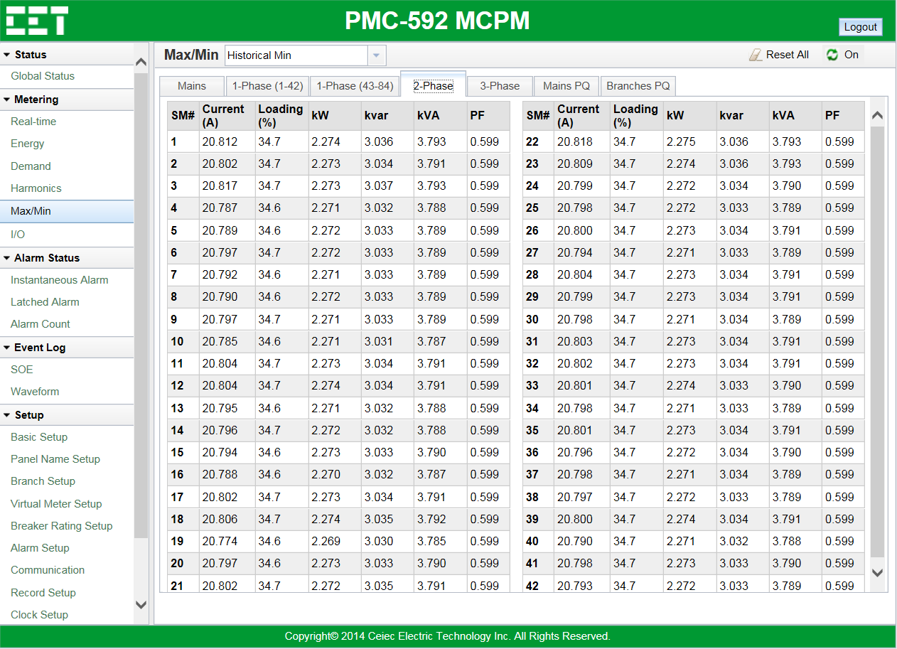
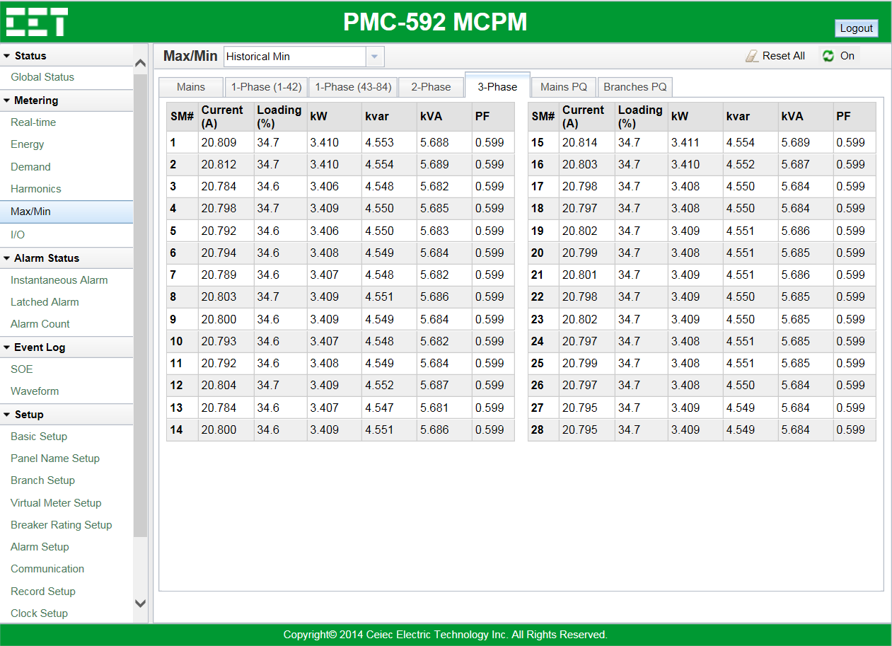
Metering — Max/Min — Branches
Measurements:
2-Phase SM1 to SM42 Current Max/Min
2-Phase SM1 to SM42 Loading Max/Min
2-Phase SM1 to SM42 kW Max/Min
2-Phase SM1 to SM42 kvar Max/Min
2-Phase SM1 to SM42 kVA Max/Min
2-Phase SM1 to SM42 PF Max/Min
Measurements:
3-Phase SM1 to SM28 Current Max/Min
3-Phase SM1 to SM28 Loading Max/Min
3-Phase SM1 to SM28 kW Max/Min
3-Phase SM1 to SM28 kvar Max/Min
3-Phase SM1 to SM28 kVA Max/Min
3-Phase SM1 to SM28 PF Max/Min

Slide 21
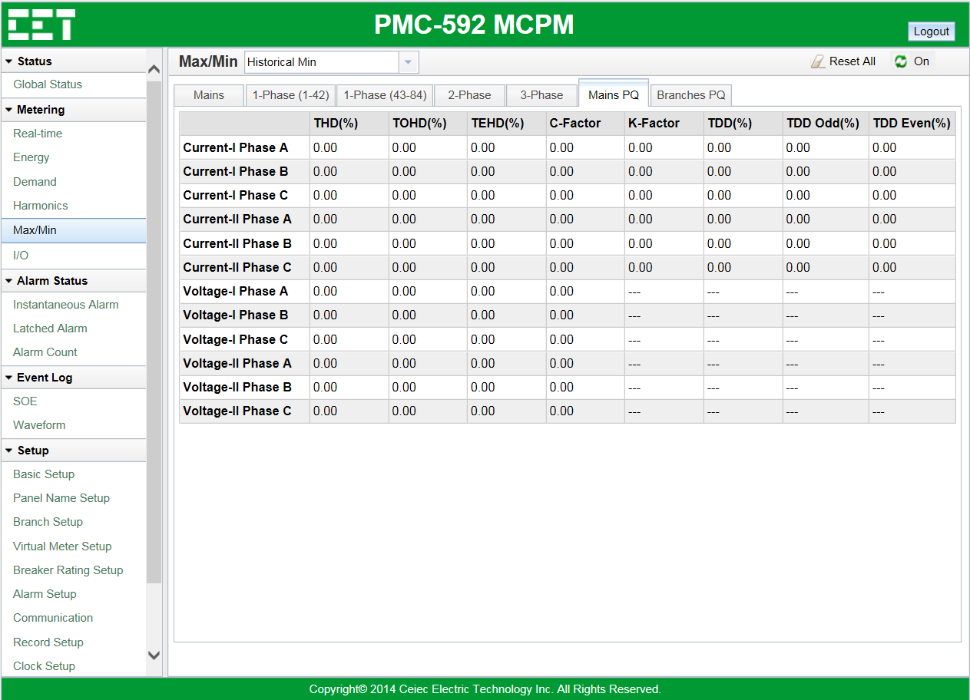
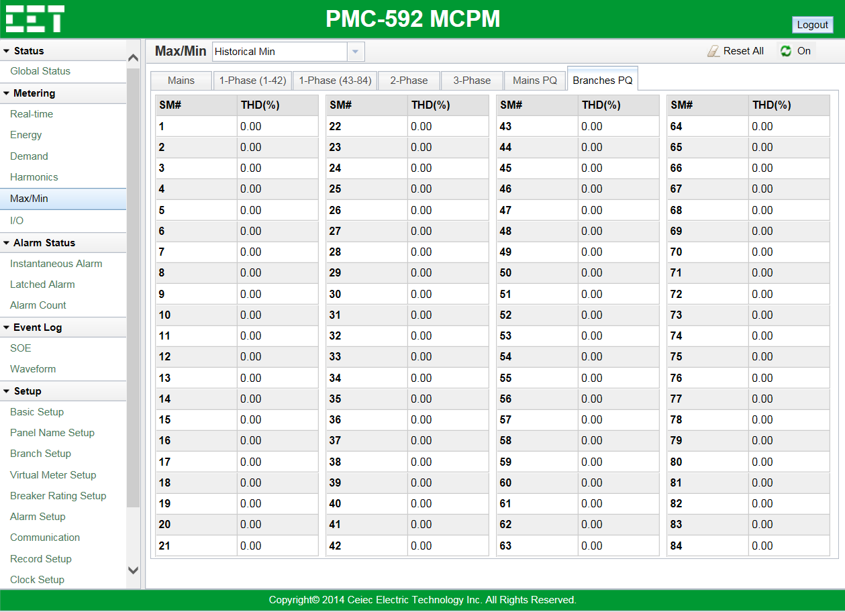
Metering — Max/Min — PQ
Measurements:
Mains-I/II Voltage THD/TOHD/TEHD Max/Min
Mains-I/II Current THD/TOHD/TEHD Max/Min
Measurements:
SM1 to SM84 THD Max/Min

Slide 22
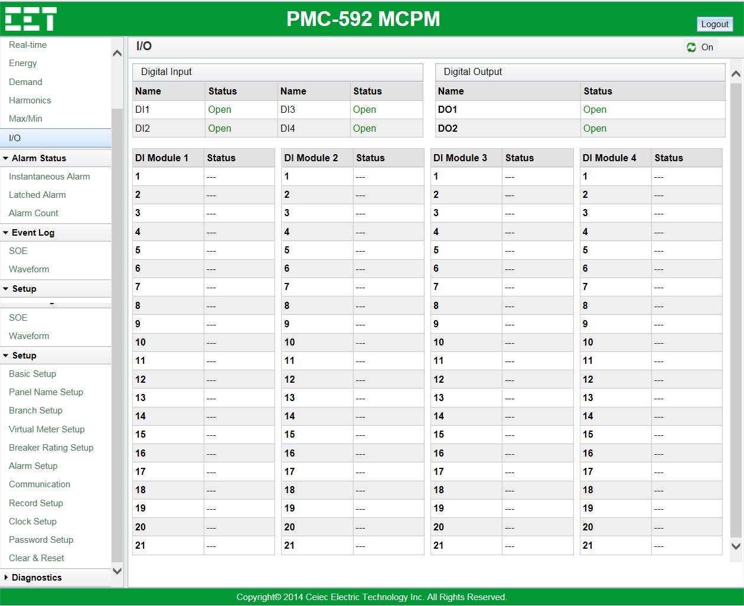
Metering — I/O
Measurements:
DI Status
DO Status

Slide 23
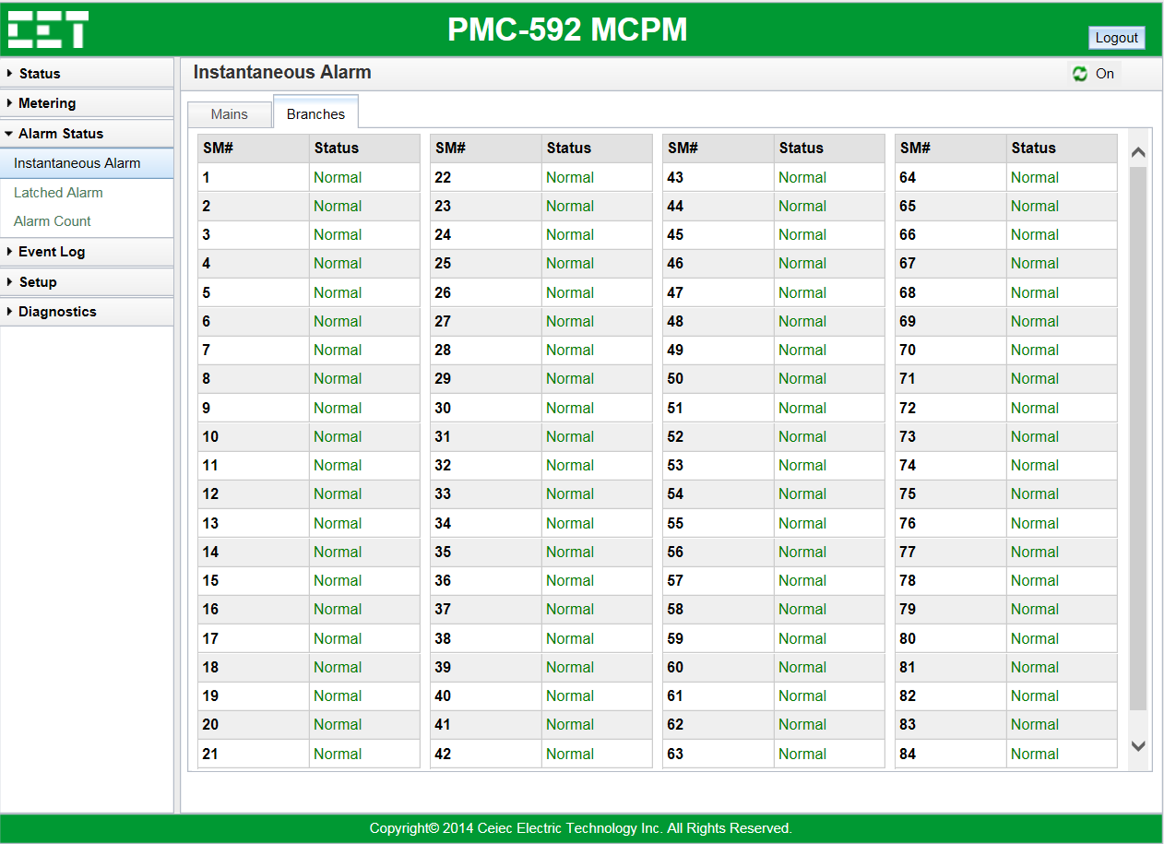
Alarm Status — Instantaneous Alarm
Measurements:
Mains-I/II Global Alarm
Mains-I/II Voltage Alarm
Mains-I/II Current Alarm
Mains-I/II Power Alarm
Mains-I/II Harmonics Alarm
Mains-I/II Unbalance Alarm
Mains-I/II DI Alarm
Mains-I/II Temperature Alarm
Measurements:
SM1 to SM84 Alarm Status

Slide 24
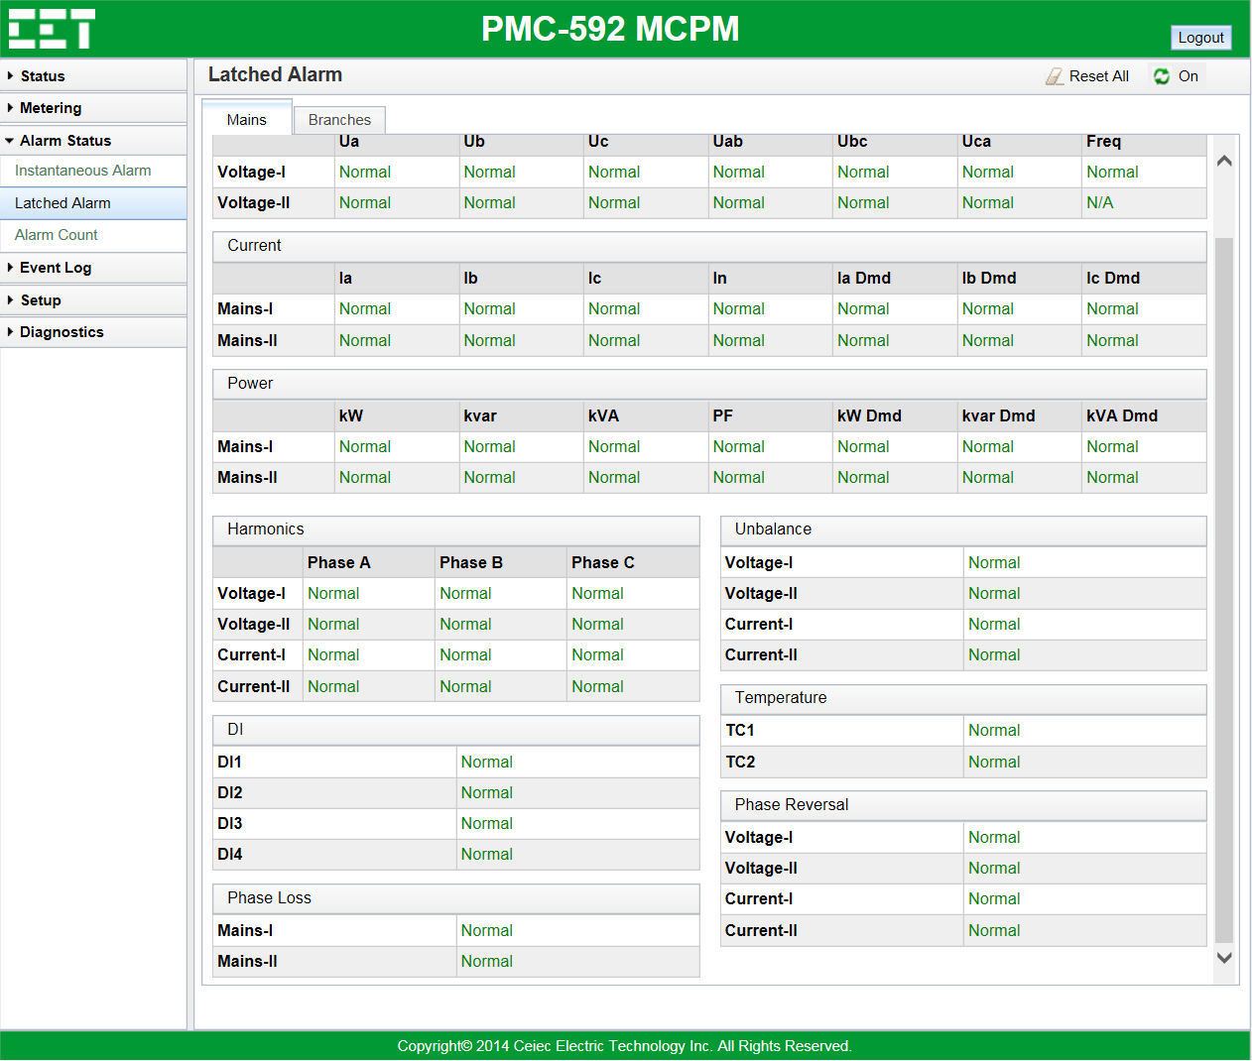
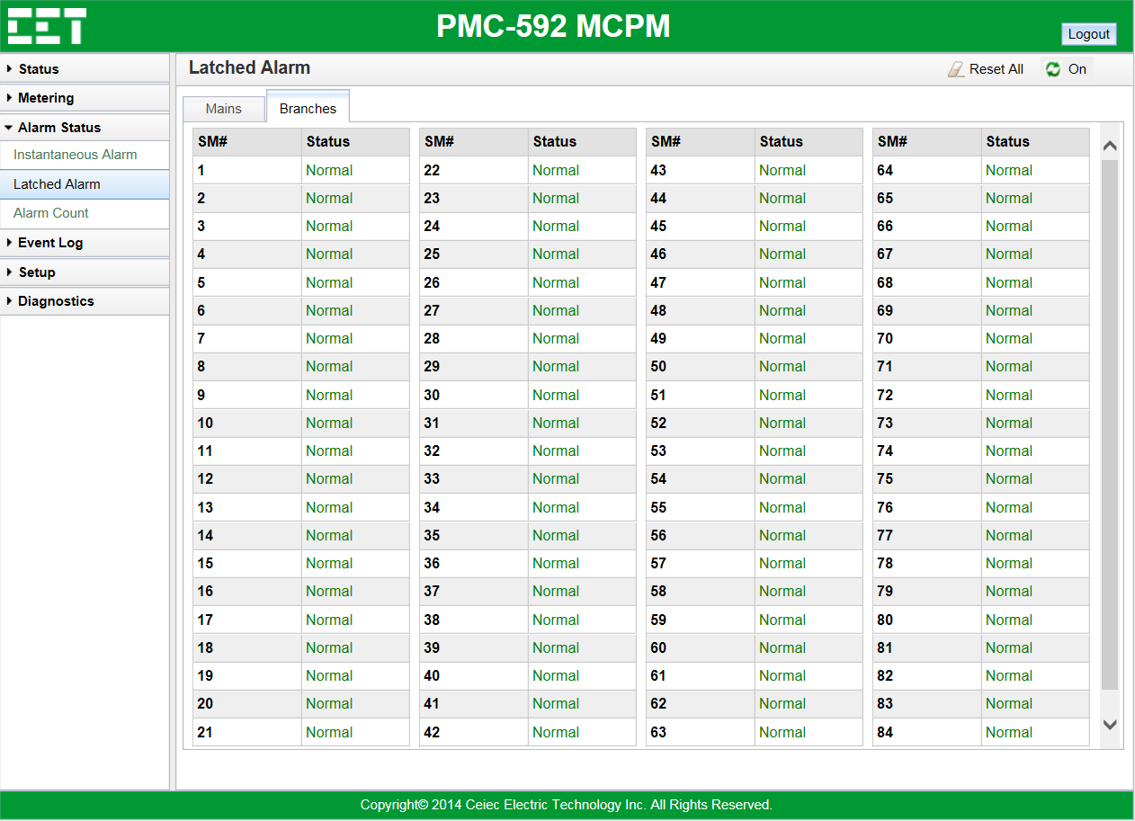
Alarm Status — Latched Alarm
Measurements:
Mains-I/II Global Alarm
Mains-I/II Voltage Alarm
Mains-I/II Current Alarm
Mains-I/II Power Alarm
Mains-I/II Harmonics Alarm
Mains-I/II Unbalance Alarm
Mains-I/II DI Alarm
Mains-I/II Temperature Alarm
Measurements:
SM1 to SM84 Alarm Status

Slide 25
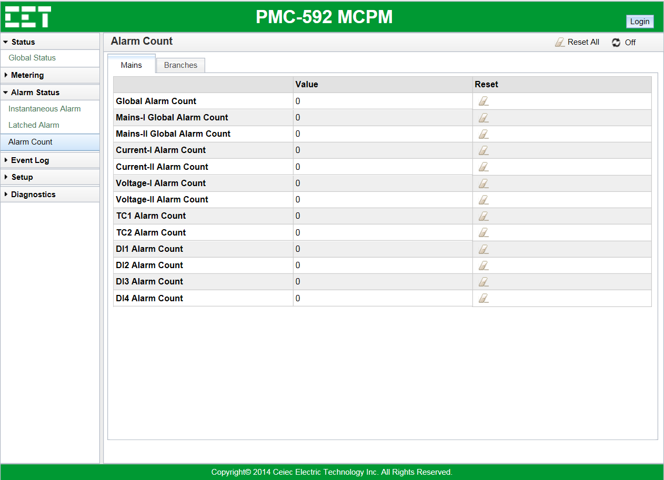
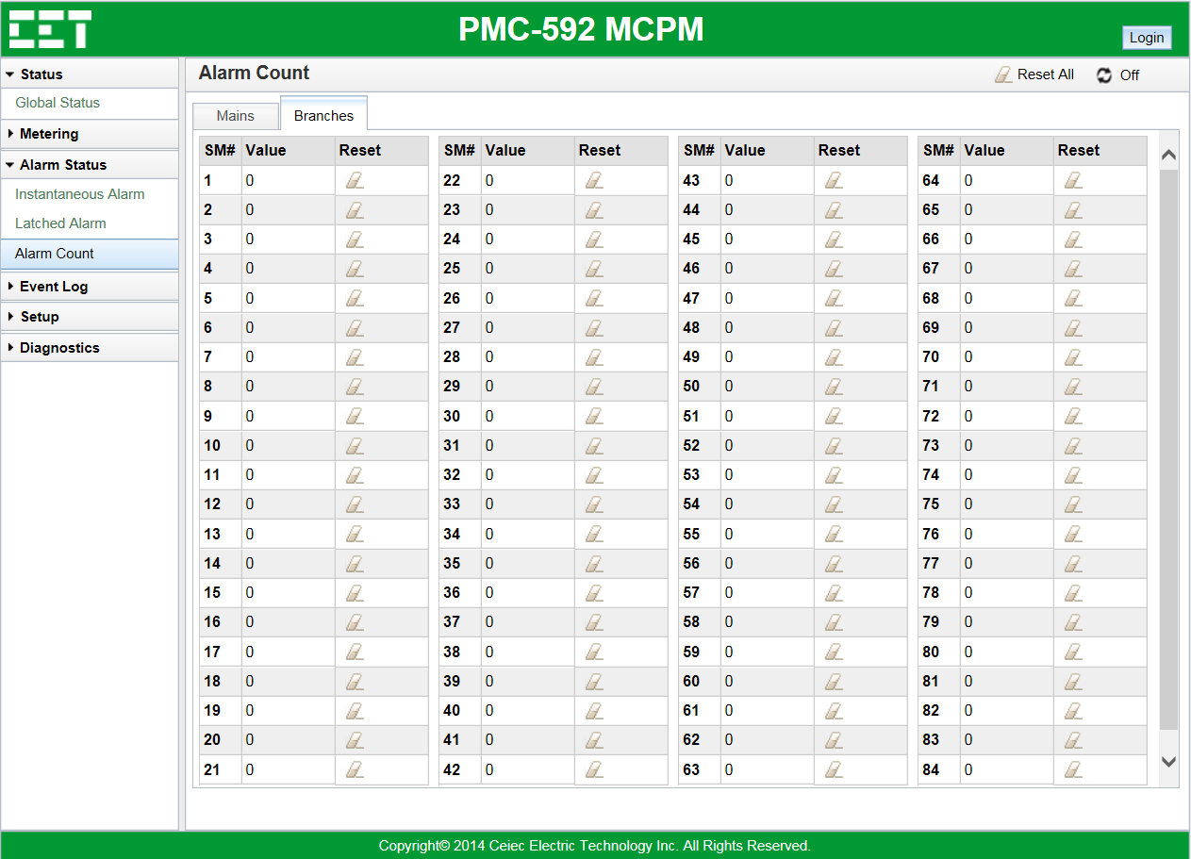
Alarm Status — Alarm Count
Measurements:
All Mains Alarm Count
Clear the count to zero by click the erase icon after every Alarm Count
Measurements:
SM1 to SM84 Alarm Count
Clear the count to zero by click the erase icon after every Alarm Count

Slide 26
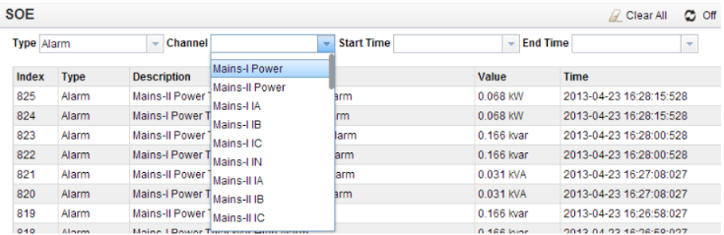
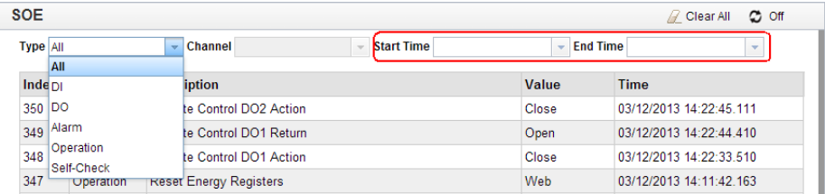
Event Log — SOE
Channel of Alarm SOE:
Mains-I/II Power
Mains-I/II Voltage
Mains-I/II Current
Mains-I/II Voltage Unbalance
Mains-I/II Current Unbalance
Frequency
RTD1/RTD2
DI1/DI2
SM1 to SM84 Current
Six Types of SOE:
All
DI
DO
Alarm
Operation
Self-Check
You can quickly find the SOE you want to check by set the Start Time and End Time in the red rectangle area of the above picture.

Slide 27
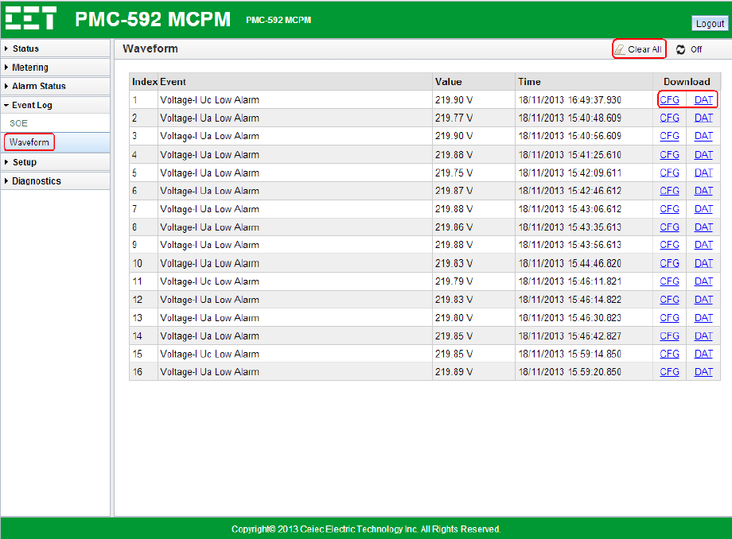
Event Log — Waveform
Click Waveform on the left-hand pane and the following screen appears on the right-hand pane.
Waveform File with format CFG or DAT can be downloaded.
Click Clear All to clear all
Waveform Logs.

Slide 28
Setup — Basic Setup
Measurements:
System Basic Settings

Slide 29
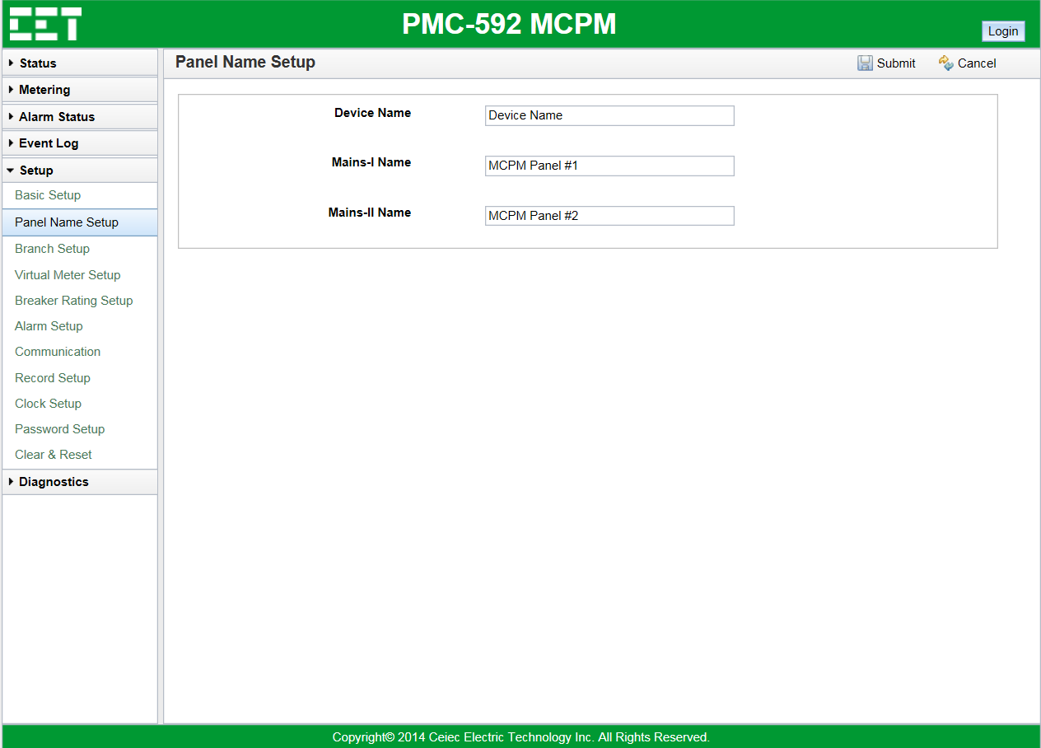
Setup — Panel Name Setup
Measurements:
Panel Name Settings
Device Name Settings

Slide 30
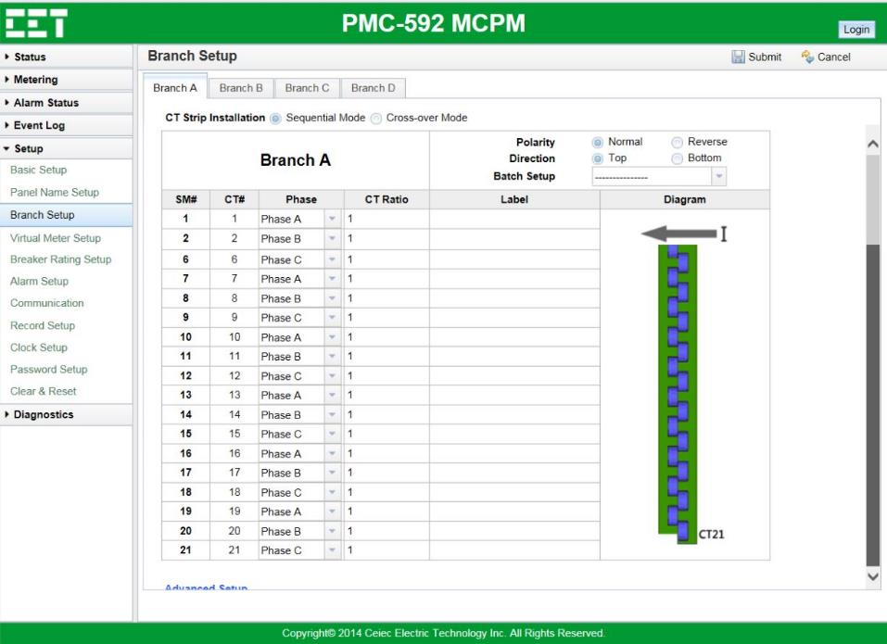
Setup — Branch Setup
Measurements:
CT Strips Installation Mode Settings
CT Strips Phases Settings
CT Strips Direction Settings
CT Strips Polarity Settings

Slide 31
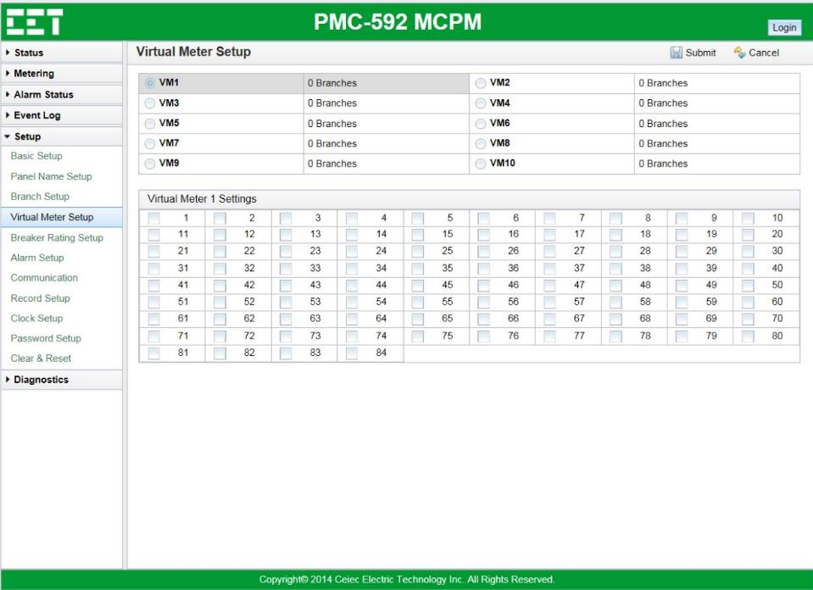
Setup — Virtual Meter Setup
Measurements:
VM 1 to VM 10 Virtual Meters Settings

Slide 32
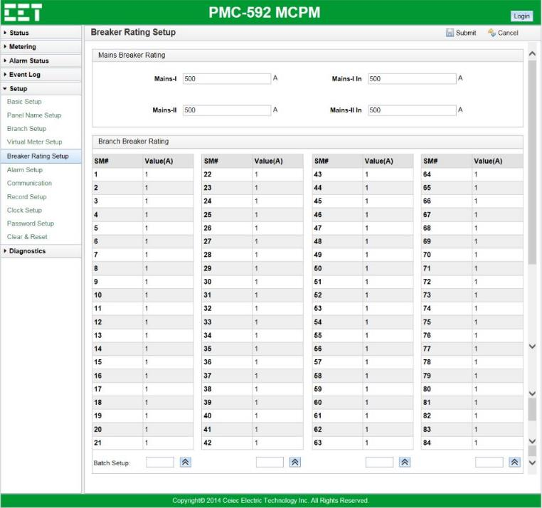
Setup — Breaker Meter Setup
Measurements:
Mains I/II Breaker Rating Settings

Slide 33
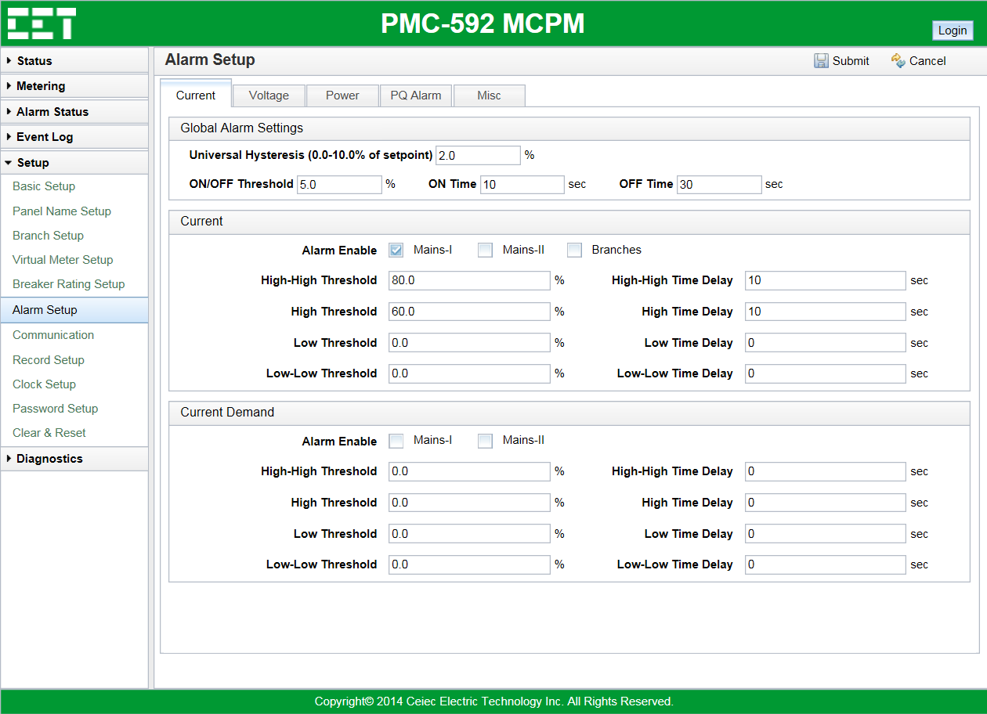
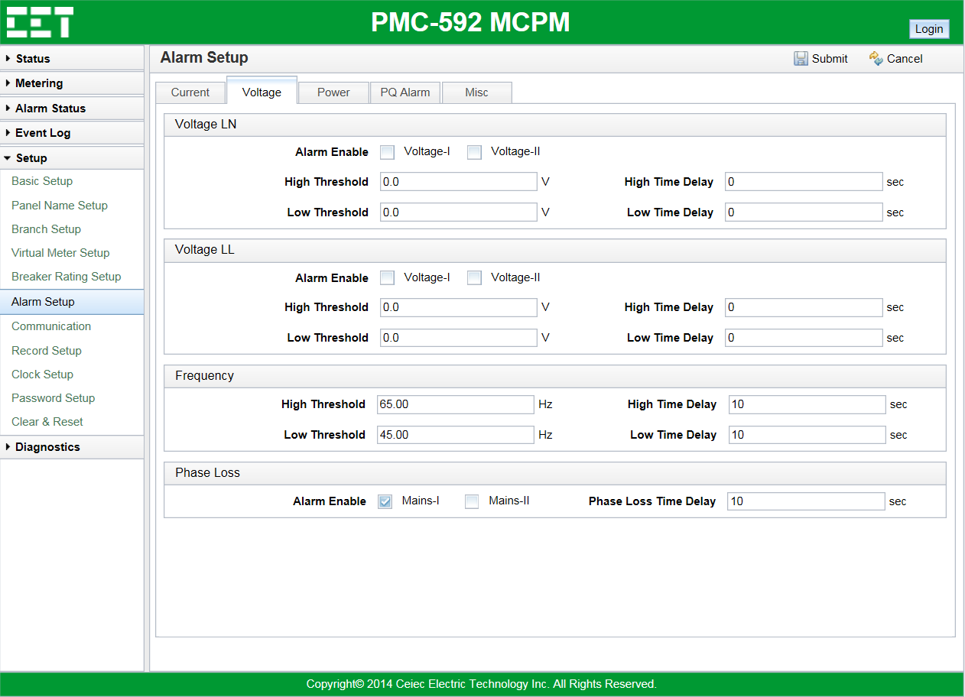
Setup — Alarm Setup
Measurements:
Current Alarm Settings
Voltage Alarm Settings

Slide 34
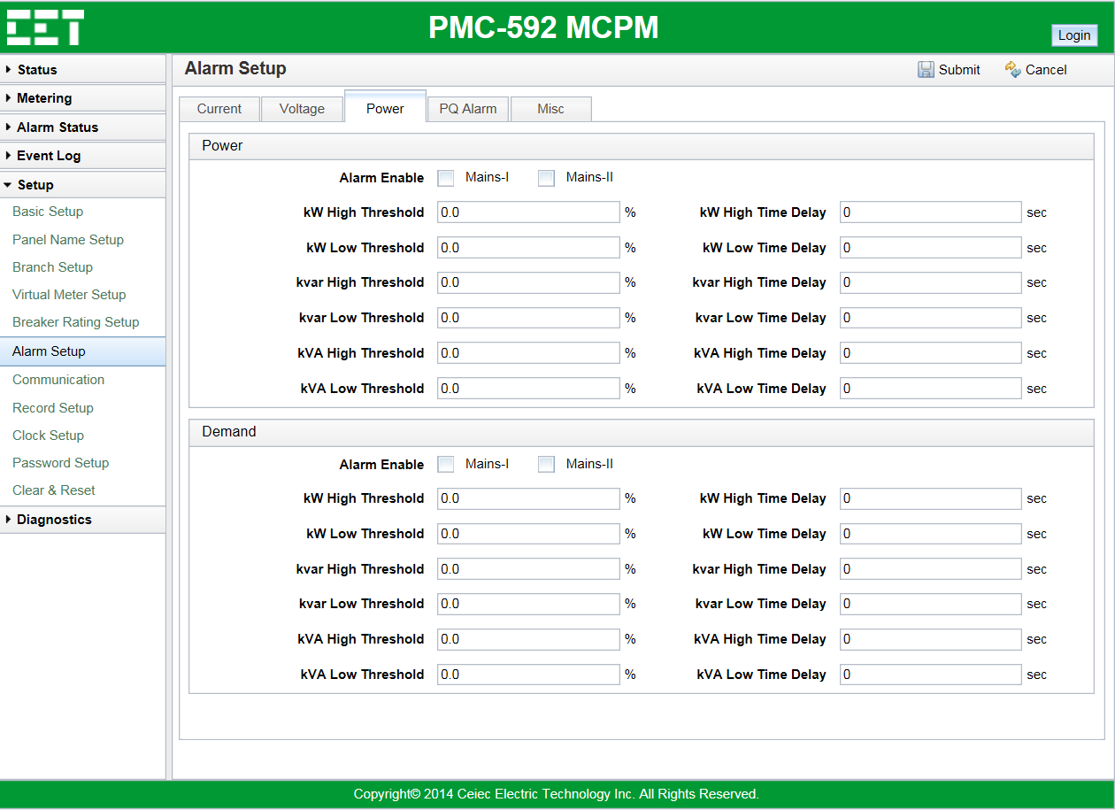
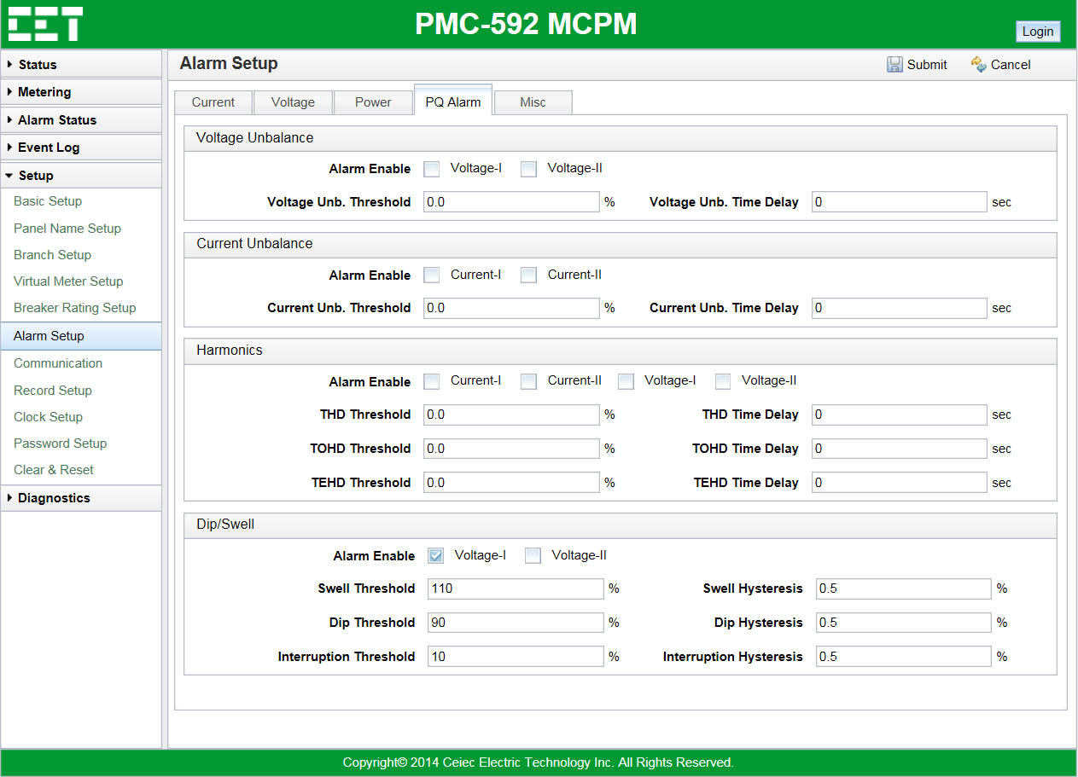
Setup — Alarm Setup
Measurements:
Power Alarm Settings
PQ Alarm Settings

Slide 35
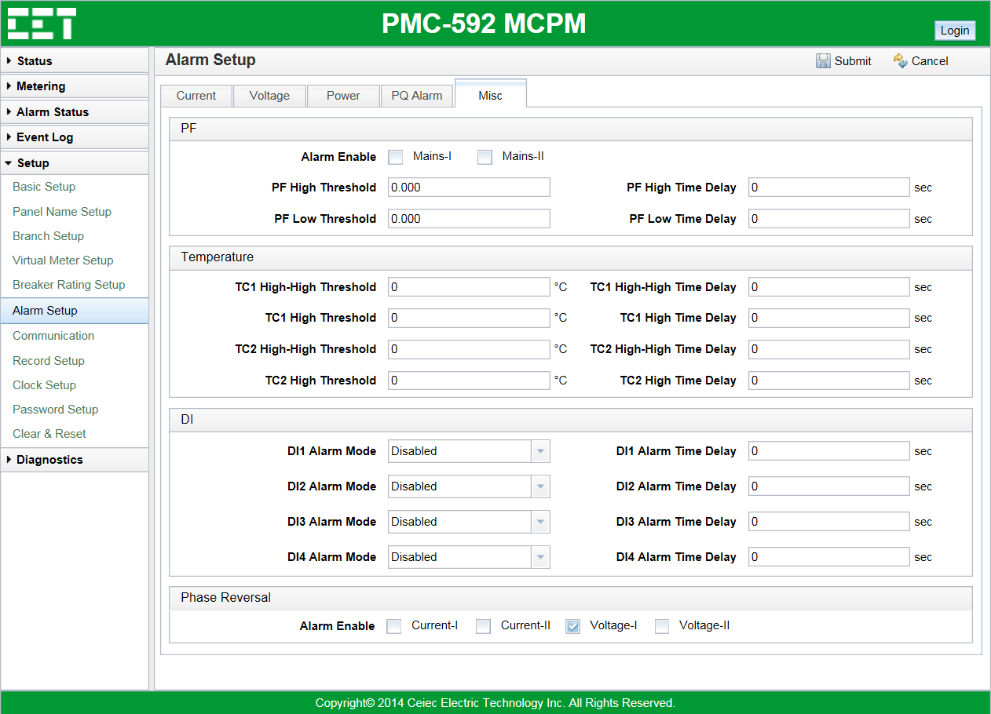
Setup — Alarm Setup
Measurements:
Misc Settings
PF
Temperature
DI
Phase Reversal Alarm

Slide 36

Setup — Communication
Measurements:
P1Communication Parameters
P2 Communication Parameters
P3 Communication Parameters
Email Settings
SNMP Settings

Slide 37

Setup — Record Setup
Measurements:
WFR Settings
Energy Log Settings

Slide 38

Setup — Clock Setup
Measurements:
Device Time Settings
SNTP Time Sync Settings

Slide 39


Setup — Password and Clear & Reset Setup
Measurements:
Device Password Settings
Measurements:
You can clear or reset the following logs
All Latched Alarms
All Alarm Counters
Energy’s
Max Demand log
Max/Min Log, SOE, WFR and Energy Logs

Slide 40

Diagnostics — About
Measurements:
System Overview
Self-Test Diagnostic

Slide 41


Diagnostics — Maintenance
Measurements:
Backup
Restore
Measurements:
Factory Defaults

Slide 42


Diagnostics — Maintenance
Measurements:
Firmware Upgrade
Measurements:
Reboot
Alarm E-mail Test
SNMP MIB Download

